Slide 1
Company Valuation:
1st Valuation Method
Discounted Cash Flow Valuation
Part I: Discount Rates
Damodaran on Valuation
  Risk Free Rates (Ch 7)
  Risk Premiums (Ch 7)
  Risk Parameters (Ch 8)
  Cost of Financing (WACC) (Ch 8)
Hillier Et al. (2010)
  Read Financial Statements (Ch 3)
  DCF (Ch 4)
  Value Bonds and Stocks (Ch 5)
  Risk and Return-Pricing Models (Part III)
Kalaitzoglou Iordanis

Slide 2
Recap: What we have seen so far
Company Valuation
DCF
Intrinsic Value
Business Oriented
Relative Valuation
Other Assets
Market Oriented
Real Options
Derivatives
Flexibility
Uncertainty
Bias
Complexity

Slide 3

Generic DCF Valuation Model
Hillier et al. (Ch 3)
Fixed Period
  Questions 4, 6 and 7
No Growth
  Questions 8 and 10
Constant Growth
  See the constant growth stage in Question 14
Two stage Growth
  Question 14
Three stage Growth
  In Case studies (session 8)

Slide 4
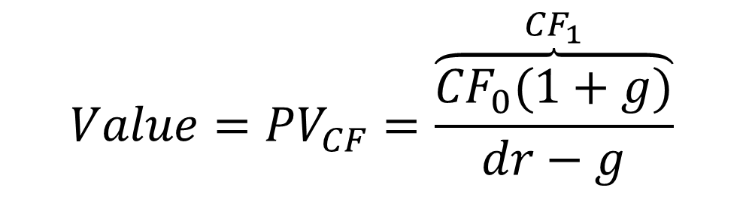
Simplest Valuation: Present value of a growing perpetuity
DCF Input I:
Which CF should I discount?
DCF Input II:
How fast do I expect this CF to grow into the future (infinity)
$$Value={PV}_{CF}=\frac{\overset{{CF}_{1}}{\overbrace{{CF}_{0}(1+g)}}}{dr−g}$$
DCF Input III:
How risky is this CF? What discount rate (dr) should I use?

Slide 5

What is a discount rate?

Slide 6
First Principle of Valuation
Never mix and match cash flows and discount rates.
The key error to avoid is mismatching CFs and discount rates,
discounting CFs to equity (CFE) at the weighted average cost of capital will lead to an upwardly biased estimate of the value of equity
discounting CFs to the firm (CFF) at the cost of equity will yield a downward biased estimate of the value of the firm.
Firm vs Equity
Currency-Inflation-Risk
The currency in which the cash flows are estimated should also be the currency in which the discount rate is estimated.
If the cash flows being discounted are nominal cash flows (i.e., reflect expected inflation), the discount rate should be nominal
Risky CF should be discounted using discount rates that reflect the risk. Certainty Equivalent cash flows should be discounted using the risk free rate.
Notes:
It is a principle that is often violated because we often talk about discount rates and cashflows loosely and costs of capital and equity interchangeably. We need to be more precise about words like free cash flow (to whom? The firm? Equity?) and discount rates to avoid these problems.
While discount rates are a critical ingredient in discounted cashflow valuation, the most significant errors in valuation are often the result of failures to estimate cash flows correctly….
As companies increasingly become global, and multiple listings abound (Royal Dutch has six equity listings in different markets) the consistently principle becomes very important. The currency used in estimating cash flows should also be the currency in which you estimate discount rates - Euro discount rates for Euro cashflows and peso discount rates for peso cash flows.
Imagine the example a valuation of a Mexican company, where the cashflows are in nominal pesos but the discount rate used is the dollar cost of capital of a U.S. acquirer…. As a result, the value would be inflated. (A discussion of inflation can be found in the introductory notes and the supporting files).
In general, you should maintain consistency in your definition of debt. If you choose to call something debt in your cost of capital calculation - operating leases, for instance - you should subtract the item out to get to the value of equity.
If you do it right, you should get the same value for equity using both approaches. (The requirement is that the debt ratio assumptions should be the same in both approaches)
The four pillars of value:
Cashflows
Potential for high growth
Length of the high growth period (before the firm starts growing at the same rate as the economy)
Discount rate
Very very important (things that we will discuss a lot in the future):
Note the variations and the need for consistency:
With equity -> Cashflows to equity - > Growth rate in net income -> Discount at the cost of equity
With firm -> Cashflows to firm - > Growth rate in operating income -> Discount at the cost of capital
A special comment should refer to how we measure cash flows to the firm. Usually, we focus on cash flows from operating assets (EBIT or Operating income). This does not include cash. Consequently, in the end we need to add cash to the value of operating assets in order to find the value of the firm (entire firm). From this value, we take out the market value of debt, to reach the market value of Equity (Residual claim).

Slide 7
Equity Valuation Dividends
Firm Valuation
FCFF
WACC
Cost of Equity
FCFE
Equity Valuation Cash Flows to Equity
Cost of Equity
Dividends
Valuation Approaches

Slide 8
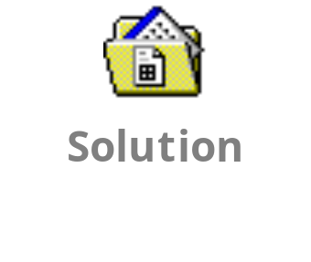
Mix and Match Example
Cash Flows and Discount Rates
Assume that you are analyzing a company with the following cashflows for the next five years. What is the value of Equity
Year | CF to Equity | Interest Exp (1-tax rate) | CF to Firm
1 | $ 50 | $ 40 | $ 90
2 | $ 60 | $ 40 | $ 100
3 | $ 68 | $ 40 | $ 108
4 | $ 76.2 | $ 40 | $ 116.2
5 | $ 83.49 | $ 40 | $ 123.49
Terminal Value (End of 5y) | $1603 |  | $2363.008
Cost of Equity | 13.625% | Cost of Debt | 10%
Tax Rate | 50%
MV Equity | $1,073 | MV Debt | $800
Notes:
Treat these cashflows as given. In the pages to come, we will talk about estimating these cashflows in detail. Note that we are assuming a perpetual bond with fixed interest payments in each period.
The costs of equity and debt are also given.

Slide 9
Discounted Cash Flow Valuation: The Steps
DCF Input I:
Cash Flow
DCF Input II:
Growth
From Earnings to Cash flows
Earnings Adjustments
Re-Investment
DCF Input III:
Discount Rate
How fast do you expect CF to grow
For how long?
How many stages?
What rate reflects risk?
Equity or firm?
Adjustments (inflation, risk)
dr can vary over time
Notes:
The process is not always sequential. It may seem irrational to pick the DCF model after you have estimated the inputs, but you have to get a sense of the cash flows and growth potential before you pick a model.

Slide 10
Future Plan
Part I: Discounted Cash Flows
Discount Rates
Risk Parameters (Beta/Determinants)
Part II: Relative Valuation
Part III: Real Options
WACC (Cost of Debt, Weights, Tax)
Future Cash Flows (Earnings, CF, Growth)
Valuation Examples
(Risk Free Rates and Risk Premiums)
This Session

Slide 11
Part I: Discounted Cash Flows
The Inputs
Estimating Discount Rates
  Cost of Equity
    Implied Rate
    CAPM
  Cost of Debt
    Cost of Bonds
    Cost of Hybrid Financing
Estimating Cash Flows
Estimating Growth

Slide 12
Carrefour vs SpaceX

Slide 13
The return of the investor is the cost of capital for the company
The discount rate of a project should be the expected return on a financial asset of comparable risk.
Notes:
This is the fundamental idea in corporate finance. The cost of capital is not defined by you, but by what others think about you. Further, what others believe about you depends on comparable assets.

Slide 14
BUT: What is Risk?
Risk, in traditional terms, is viewed as a ‘negative’. Webster’s dictionary, for instance, defines risk as “exposing to danger or hazard”. The Chinese symbols for risk, reproduced below, give a much better description of risk
  危機
The first symbol is the symbol for “danger”, while the second is the symbol for “opportunity”, making risk a mix of danger and opportunity. You cannot have one, without the other.
Notes:
Note that risk is neither good nor bad. It is a combination of danger and opportunity - you cannot have one without the other. Consequently, risk is neither something to be avoided nor sought out but carefully balanced. Good business avoid some risks, let others pass through to their investors and actively seek out still others.
When businesses want opportunity (higher returns), they have to live with the higher risk.
Any sales pitch that offers returns without risk is a pipe dream.
Bob Citron, treasurer of Orange County (CA), after he lost a chunk of the county’s pension fund money after investing in interest rate derivatives claimed that he was “not a finance person” and that Merrill’s market strategist (Charlie Clough) had told him he could make “15% with no risk”.
Many prominent (and intelligent) people invested with Bernie Madoff because he promised them (through third parties) that he could deliver 8% more than the treasury bill rate, guaranteed. (He was called the Jewish T.Bill). One investor, interviewed by the NY Times said, “I really did not understand what he was doing, but he said was going to do something with calls, something with puts and earn 12% every year. It sounded plausible (and all my friends were investing with him too).

Slide 15
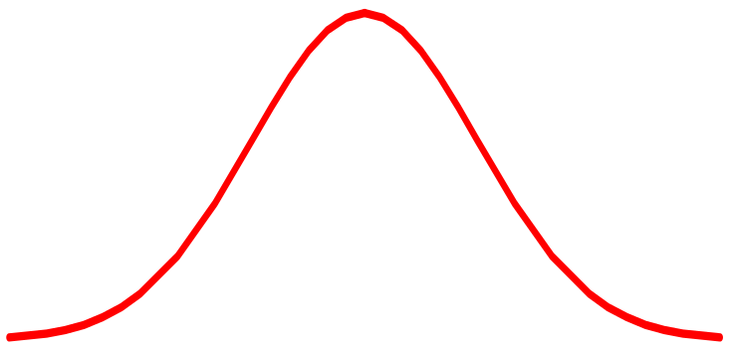
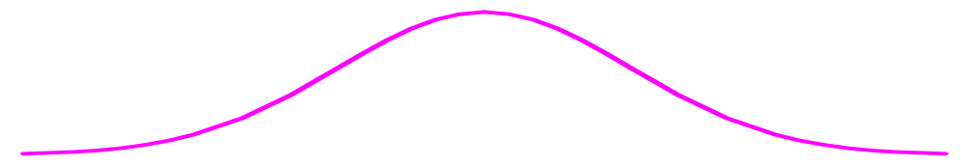
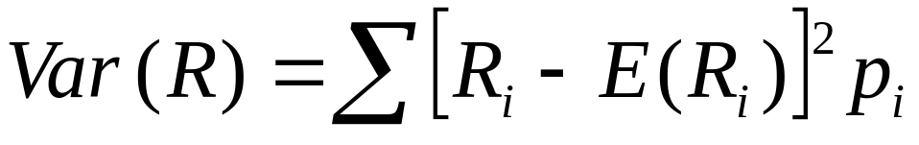
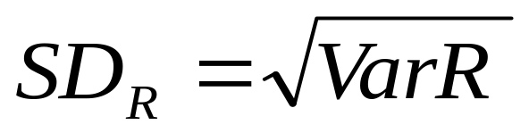
Risk is measured by the Standard Deviation of returns of a security.
Firm X
Firm Y
Rate of
Return (%)
-70
0
15
100
Expected Rate of Return E(Ri)
Notes:
What is investment risk?
Two types of investment risk
Stand-alone risk
Portfolio risk
Investment risk is related to the probability of earning a low or negative actual return.
The greater the chance of lower than expected or negative returns, the riskier the investment.
Practically
Stock X
has an expected return equal to 15%
We can be 90% sure that the return we will get will be between 0 and 30%
Stock Y
has and expected return equal to 15%
We can be 90% sure that the return we will get will be between -60 and 80%
Which one would you chose?

Slide 16
Diversification and types of risk
Systematic
Risk
Unsystematic Risk
Total Risk
Notes:
A bit of Theory
Risks in individual asset returns have two components:
Systematic risks – common to all assets. They are non-diversifiable
Unsystematic risks – specific to individual assets. They are diversifiable
Forming portfolios can eliminate unsystematic risks(Markowitz(1952, 1959)
Investors are Risk averse (would invest in a riskier asset for extra return)
They choose the highest return for a given risk
The minimum risk for a given return

Slide 17

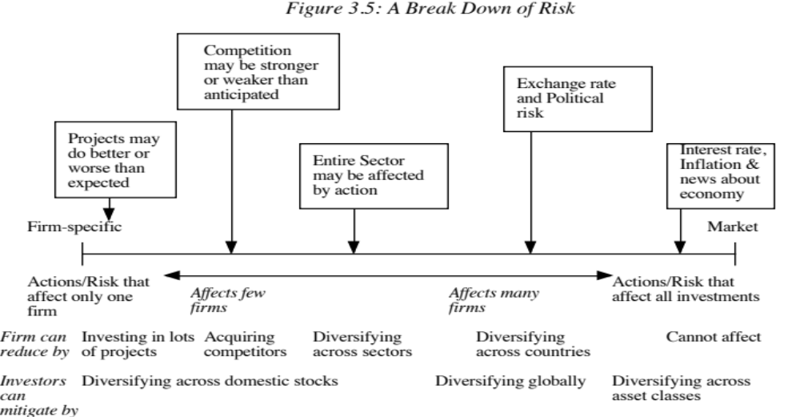
Different Types of Risk

Slide 18
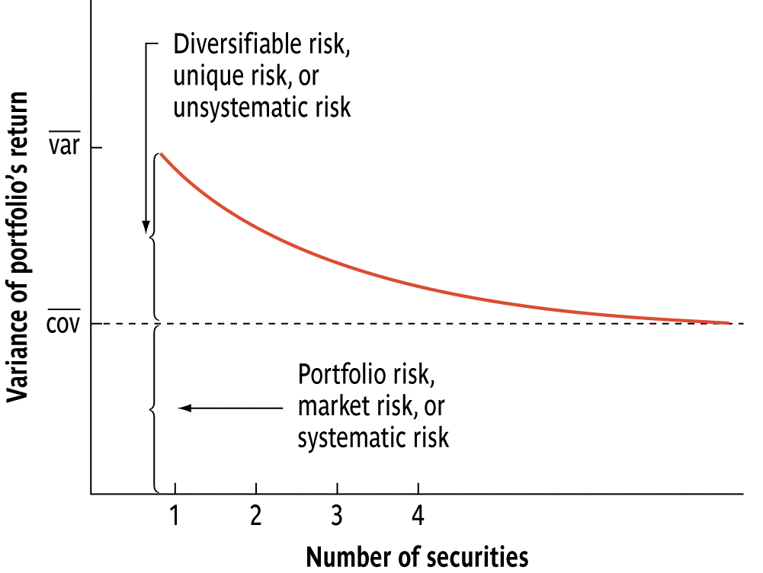
Diversification: An Example
Diversification can reduce Unsystematic risk
Notes:
RISK AND DIVERSIFICATION
This is a strategy designed to reduce risk by spreading the portfolio across many investments. Markowitz(1952, 1959)
Diversification is believed to reduce variability (risk)
Portfolio diversification works because prices of different stocks do not move exactly together.
Diversification works best when the returns are negatively correlated.
DIVERSIFICATION-Failure to diversify
If an investor chooses to hold a one-stock portfolio (exposed to more risk than a diversified investor), would the investor be compensated for the risk they bear?
NO!
Stand-alone risk is not important to a well-diversified investor.
Rational, risk-averse investors are concerned with σ_{p}, which is based upon market risk.
There can be only one price (the market return) for a given security.
No compensation should be earned for holding unnecessary, diversifiable risk.
Breaking down sources of risk
Total Risk = Market risk + Firm-specific risk
Market risk – portion of a security’s stand-alone risk that cannot be eliminated through diversification.
Firm-specific risk – portion of a security’s stand-alone risk that can be eliminated through proper diversification.
Investors holding a diversified portfolio are mostly concerned with macroeconomic risks since micro risks are washed out in diversified portfolio.

Slide 19
Cost of Equity
{Risk and Return (CH 4)}
Risk and Return
The cost of equity should be higher for riskier investments and lower for safer investments
Risk and Discount Rate
While risk is usually defined in terms of the variance of actual returns around an expected return, risk and return models in finance assume that the risk that should be rewarded (and thus built into the discount rate) in valuation should be the risk perceived by the marginal investor in the investment
Type of Risk
Most risk and return models in finance also assume that the marginal investor is well diversified, and that the only risk that he or she perceives in an investment is risk that cannot be diversified away (i.e, market or non-diversifiable risk)
Notes:
Re-emphasizes a key assumption that we make in risk and return models in finance. It is not risk that matters, but non-diversifiable risk and the cost of equity will increase as the non-diversifiable risk in an investment increases.
This view of the world may pose a problem for us when valuing private companies or closely held, small publicly traded firms, where the marginal investor (owner, venture capitalist….) may not be diversified.
Please note the difference between the risk averse investor and the marginal investor. Risk averse investor only bears extra risk when there is extra return. What risk are they asked to be compensated for, though? Only for systematic risk. Another major point is that they are not price takers (when they trade, they change prices).
More specifically,
The argument that diversification reduces an investor’s exposure to risk is clear both intuitively and statistically, but risk and return models in finance go further. The models look at risk through the eyes of the investor most likely to be trading on the investment at any point in time, i.e. the marginal investor. They argue that this investor, who sets prices for investments, is well diversified; thus, the only risk that he or she cares about is the risk added on to a diversified portfolio or market risk. This argument can be justified simply. The risk in an investment will always be perceived to be higher for an undiversified investor than for a diversified one, since the latter does not shoulder any firm-specific risk and the former does. If both investors have the same expectations about future earnings and cash flows on an asset, the diversified investor will be willing to pay a higher price for that asset because of his or her perception of lower risk. Consequently, the asset, over time, will end up being held by diversified investors.
The marginal investor in a firm is the investor who is most likely to be the buyer or seller on the next trade and to influence the stock price. Generally speaking, the marginal investor in a stock has to own a lot of stock and also trade a lot. Since trading is required, the largest investor may not be the marginal investor, especially if he or she is a founder/manager of the firm (Michael Dell at Dell Computers or Bill Gates at Microsoft) In all risk and return models in finance, we assume that the marginal investor is well diversified.

Slide 20
Risk in a firm is reflected on its cost of capital.
Therefore, Discount Rate should be at least as much as that.
How Firms Borrow Capital
Equity
Debt
Bank Borrowing
Ordinary
Bonds
Debentures
Coupon
Discounted
Hybrid Borrowing
Preferred/
Debenture Stock/ Hybrid Bonds
Notes:
Investors are willing to lend money to a company and expect a return that compensates them for the risk they bear
This return is paid by the company. Consequently, investors expected return is the cost of capital of the company
The cost (in the form of Dividends/Coupons/Discounted Value etc.) of any form of capital is determined by investors’ expectations.

Slide 21
Cost of Equity
Cost of borrowing using new equity
Ordinary Shares
CAPM
Dividend
Growth
Constant Dividend
Implied

Slide 22
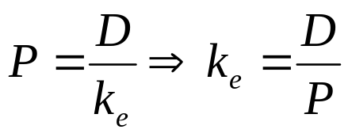
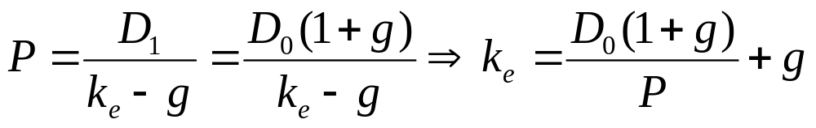
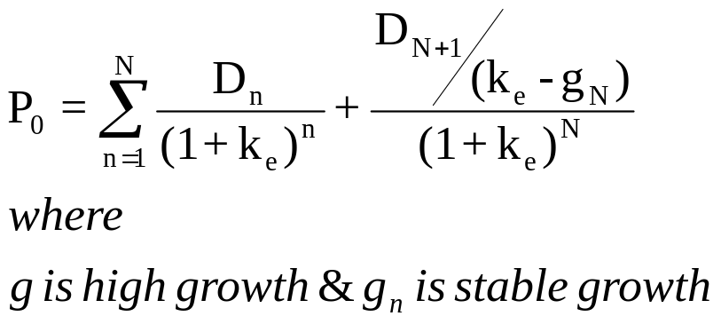
Cost of Equity-First Approach a. Implied Rates-Growth Models
No Growth
Stable Growth or Gordon Growth model
2-Stage Growth
Dividend
Price
Cost of Equity
Growth
Notes:
This approach Assumes that the market is efficient on the long term. The price you see today summarizes all expectations and it reflects the required return of the investors. Given that companies tend to stick to a dividend policy, we can have reasonable forecasts of the future CF. The price today should be determined by the required return.
The above line of thoughts is consistent when we need to use the cost of capital as discount rate. The (implied) rate we find above is current and it shows what the cost of borrowing today would be. Given that the valuation is a forward looking process to find a current value, it makes sense to use forward looking required returns.
In the 2-stage growth model it might be quite tricky to solve for cost of equity. In this case the easiest approach is to apply different discount rates. When you reach two that you are sure that cost of equity is in between, you can apply the interpolation method (More information on the appendix, in the end of this slide series.)

Slide 23
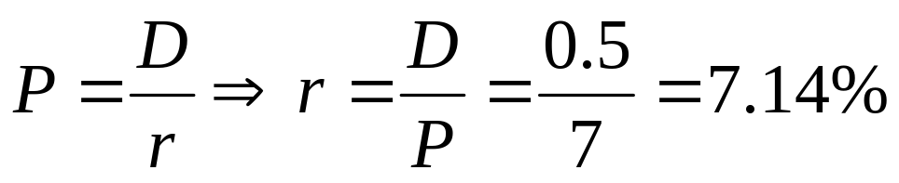
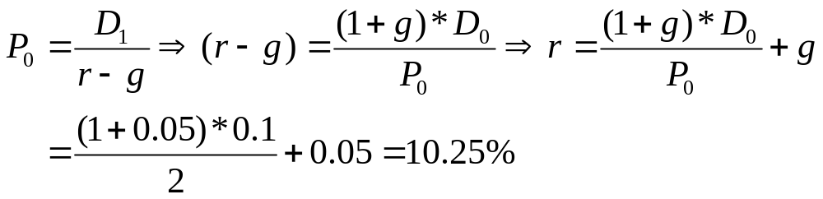


Examples
Jordan plc follows a constant dividend policy of 50p annual dividend. Investors are willing to pay today £7 for Jordan’s shares. What is Jordan’s cost of equity capital (required return)?
Suppose that Coventry plc just paid a10p dividend per share. The management team wants to maintain a constant dividend growth, equal to 5% a year. Investors are willing to pay £2 to buy Coventry’s share. What is the required return (cost of equity capital) of Coventry’s share?

Slide 24
Cost of equity for Nestle

Slide 25
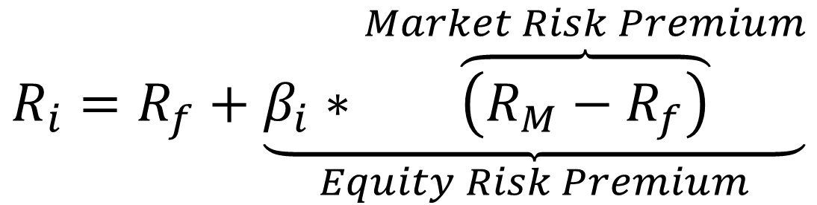
Cost of Equity-Second Approach b. CAPM (CH 4)
$$R_{i}=R_{f}+\underset{Equity Risk Premium}{\underbrace{β_{i}∗\overset{Market Risk Premium}{\overbrace{\left(R_{M}−R_{f}\right)}}}}$$
Asset Returns (rj) depend on:
The Risk Free Rate of return (rf)
    Short term government security rates are used as risk free rates
The Market Equity Risk Premium (rm-rf)
    Historical risk premiums are used for the risk premium
The Corporate Risk Premium β x (rm-rf)
    Betas are estimated by regressing stock returns against market returns
Notes:
Risk Free Rate
Represents the time value of money
It is the expected return of a risk free asset
It is approximated using the Treasury bond interest rate (considered to be risk free)
It is exogenous determined (changes for reasons irrelevant to asset’s price changes) and it can change many times each day. However in calculations assumed to be constant (at least for a period)
Market Risk Premium
Considering the risk-return relation, it represents the average extra return (over the risk free rate) of the market’s portfolio
All assets traded in a market require an extra return for bearing extra risk, when investing in them. The average extra risk is the Market Risk Premium
Market’s portfolio is assumed to have b=1
In other words, it is the systematic (can be diversified or compensated) risk of the market portfolio
It is exogenous and it can change many times a day
Corporate Risk Premium
Represents the extra return required for investing in a specific asset
It is the systematic risk related to a specific investment
The amount of risk included in a specific asset is measured (approximated) by beta

Slide 26
Comparing Expected return and asset betas
Security Actual Return Beta
HT 17.4% 1.30
Mkt 15.0 1.00
PM 13.8 0.89
T-Bills 8.0 0.00
COLL 1.7 -0.87
Riskier securities have higher returns, so the rank order is OK.
Find the expected returns

Slide 27
Calculating Required Rates of Return
R_{HT} = 8.0% + (15.0% - 8.0%)(1.30)
= 8.0% + (7.0%)(1.30)
= 17.10%
RMkt = 8.0% + (7.0%)(1.00) = 15.00%
RPM = 8.0% + (7.0%)(0.89) = 14.23%
_{RT-bill} = 8.0% + (7.0%)(0.00) = 8.00%
Rcoll = 8.0% + (7.0%)(-0.87) = 1.91%

Slide 28
SML: Security Market Line
Depicting CAPM Graphically beta and Expected Return
R_{i} (%)
SML
.
HT
Undervalued-Buy
HT
.
.
R_{Mkt} = 15
R_{F} = 8
.
PM
Overvalued-Sell
.
T-bills
Risk, β_{i}
-1 0 1 2
Coll.
SML: R_{i} = 8% + (15% – 8%) x β_{i}
Notes:
R% E(R)%
HT 17.1 17.4 undervalued
Mkt 15.0 15.0 fairly valued
PM 14.2 13.8 overvalued
T-Bill 8.0 8.0 fairly valued
Coll 1.9 1.7 overvalued

Slide 29
i. Risk Free Rate
Short term Governments are not risk free….
On a risk free asset, the actual return is equal to the expected return. Therefore, there is no variance around the expected return.
For an investment to be risk free, then, it has to have
  No default risk
  No reinvestment risk
Thus, the risk free rates in valuation will depend upon when the cash flow is expected to occur and will vary across time.
In valuation, the time horizon is generally infinite, leading to the conclusion that a long-term risk free rate will always be preferable to a short term rate, if you have to pick one.

Slide 30
Risk Free Rate: 4 different cases
A Risk Free Rate in $
A Risk Free Rate in €
A Risk Free Rate in Local Currency for a Local Company
A Risk Free Rate in Local Currency for an International Company
Suitable for American Companies with CF in $
Suitable for European Companies with CF in €
Suitable when no risk free entities can be found
Suitable for companies in emerging markets that have international exposure. Cash Flows might be in $ or €

Slide 31
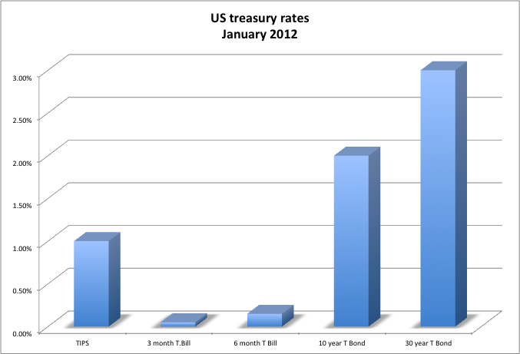
Case 1: A riskfree rate in US dollars!
In valuation, we estimate cash flows forever (or at least for very long time periods). The right risk free rate to use in valuing a company in US dollars would be
A three-month Treasury bill rate
A ten-year Treasury bond rate
A thirty-year Treasury bond rate
A TIPs (inflation-indexed treasury) rate
None of the above
Notes:
Since we are valuing cashflows for the long term, we want a long-term riskfree rate (so, rule out the 6-month T.Bill rate). Since the valuation is in US dollars (a nominal rate), we can also rule out the TIPS rate (Please note that if you use deflated cash flows, then this might be your rate). In theory, the 30-year rate should be the best choice. In practice, You might decide to go with the 10-year bond for the following reasons:
It is the most liquid of the treasuries and there is always a fresh auction rate from the previous Monday,
Getting other inputs such as equity risk premiums and default spreads is easier with a 10-year rate than a 30-year rate
The term structure flattens out by the time you get to the 10-year rate…..
In September 2011, none of the above may be a legitimate answer, though.. After all, S&P had just downgraded sovereign rating for the US from AAA to AA+… suggesting an uptick of default risk…
Same in January 2015. ECB has launched a massive QE program and therefore bond yields universally (more in countries that are closely linked to Euro) have decreased drastically. This does not necessarily mean that the overall risk of these countries is lower.
Data can be found here
http://www.treasury.gov/resource-center/data-chart-center/interest-rates/Pages/TextView.aspx?data=yield
http://www.bloomberg.com/markets/rates-bonds/government-bonds/us/
http://money.cnn.com/data/bonds/
http://news.morningstar.com/TreasuryYield/bonds.aspx

Slide 32
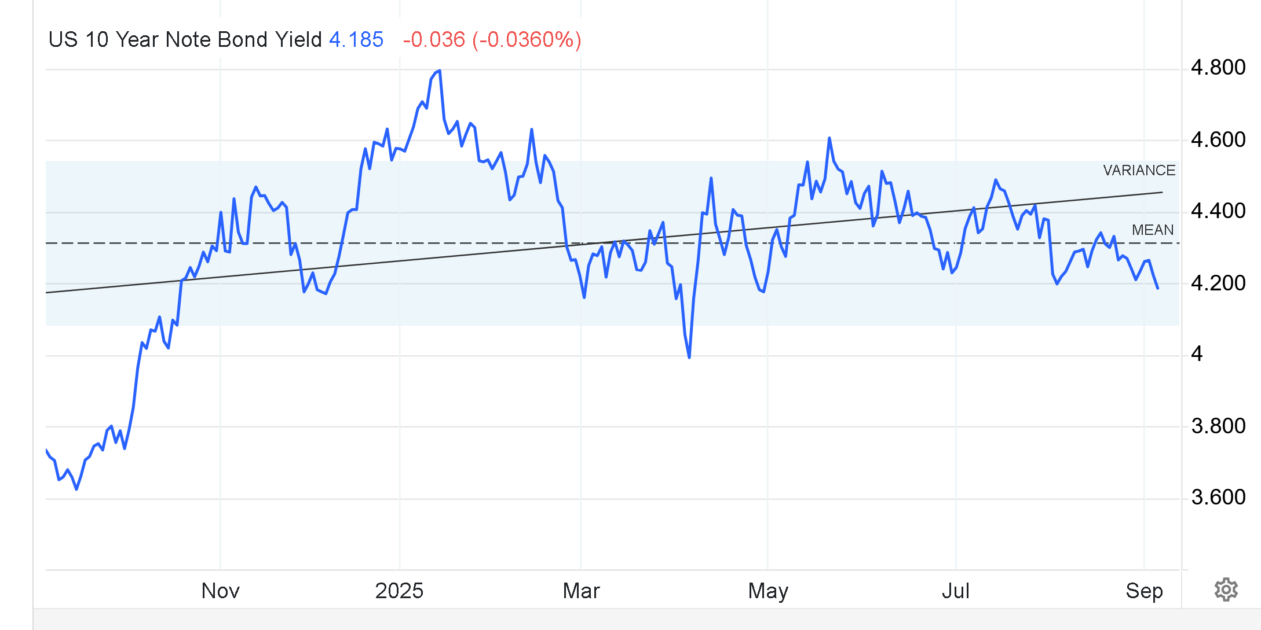
When should we consider the rate to be risk free
1 year history of 1oy bond yields
Notes:
Source for the data
http://www.tradingeconomics.com/united-states/government-bond-yield
There is no direct answer as to when the yields reflect a risk free entity. This is actually the wrong question. As we have said before,, there is no risk free entity. We do a comparable analysis. We take the one with the least possible probability of default and we consider it less risky compared to all other securities in the same currency. This does not mean that it is risk free and it is expressed in real (rather than in nominal) values.
The answer and the use of an appropriate rate depends on what assumptions we make.
If we assume that the market NOW reflects all the information at the moment and does not misprices this asset, we should take the current one.
If we consider that on average over time the market gives a correct valuation, then we take a (simple, weighted, etc.) average
If we think that now the market is affected by a major macroeconomic event (like the stop of a quantitative easing program, or contagious effects etc.),, then we might consider a historical, rather than a current yield.

Slide 33
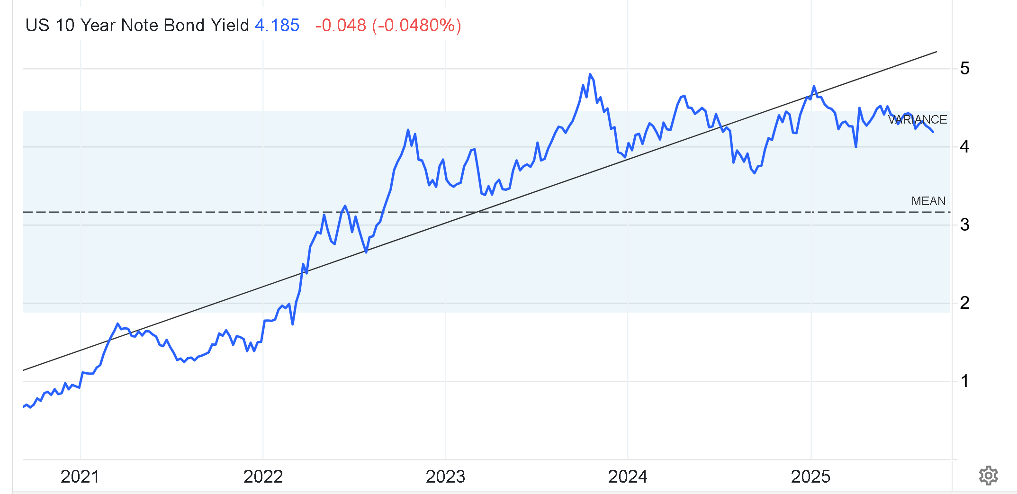
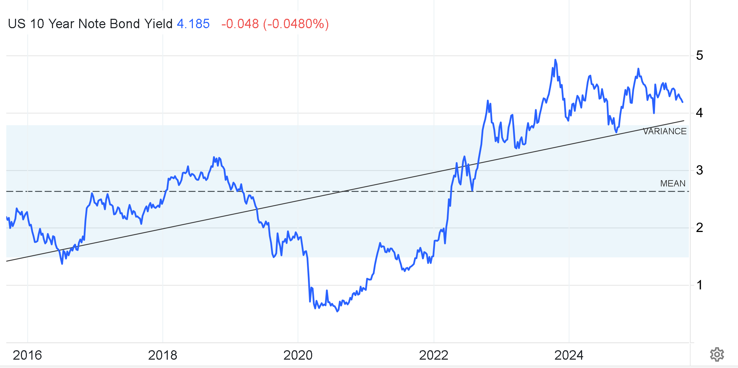
What if we consider 5 or 10 years history

Slide 34
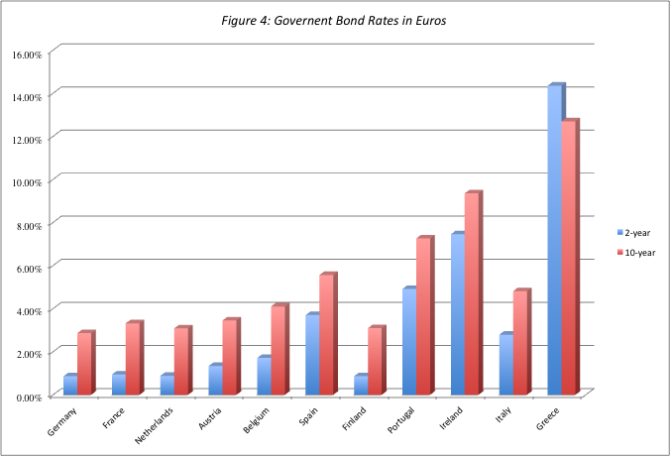
Case 2: A Riskfree Rate in Euros (2010)
???
Does Greece have a risk free rate
???
Notes:
The only reason for differences in rates across these securities is default risk. Consequently, it makes sense to use the lowest of the rates (Germany) as the risk free rete, if you are valuing a company in Euros.
We have discussed that we cannot theoretically justify the existence of a risk free asset. However, we can think of the lowest return as the safest, which in relative terms is less risky than any other asset. Consequently, investments in any other (riskier) asset requires a premium.
More recent data can be found here
http://markets.ft.com/research/Markets/Bonds
http://www.calculatedriskblog.com/p/european-bond-yields.html
https://www.ecb.europa.eu/stats/money/yc/html/index.en.html
A very interesting story about the QE program announced January 2015 by ECB
http://www.cnbc.com/id/102353935

Slide 35
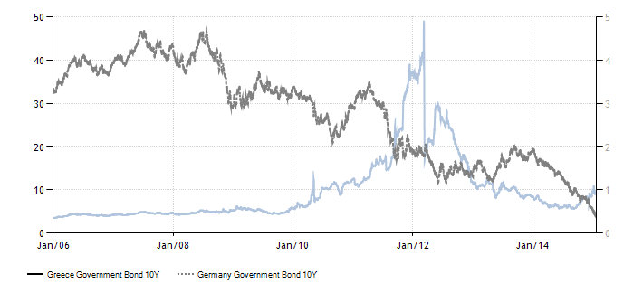
Even Worse
When do we consider the German bond to be risk free
Notes:
The problem evidently highlighted in this graph is what we call contagious effects. The Greek bonds have become very risky. Therefore, investors “flee” to “safe” assets. This has as a result the increase (decrease) of the price of the safe (risky) assets. Therefore, their yields decrease (increase).
When are the rates clean of contagious effects?
This is a very tricky question. Again there is no clear answer. We need to make an assumption. Especially for 2015, the yields are heavily depending on the QE program of ECB + the impact o riskier securities of the European periphery. This means that the estimate of the German bond yield is significantly lower than it should be, based on the fundamentals of the country. What we choose depends on what we believe/expect/assume
One school of thought follows the idea that we need to evaluate the business today and so we take the (today’s) estimate of the least risky asset.
Another school of thought focuses on the fact that the evaluation is a forward looking process. What we try to do is the price that the asset should be valued at. If we consider that the current condition of the market is temporary (this is like assuming that the market soon will move towards a known direction, i.e., the end of the QE program), then we might better consider a longer term average rate.
Again, I hope that you started realising that everything depends on our assumptions

Slide 36
Case 3: Local Currency
A Riskfree Rate in Indian Rupees
The Indian government had 10-year Rupee bonds outstanding, with a yield to maturity of about 8.5% on January 1, 2012.
In January 2012, the Indian government had a local currency sovereign rating of Baa3. The typical default spread (over a default free rate) for Baa3 rated country bonds in early 2012 was 2%.
The riskfree rate in Indian Rupees is
The yield to maturity on the 10-year bond (8.5%)
The yield to maturity on the 10-year bond + Default spread (10.5%)
The yield to maturity on the 10-year bond – Default spread (6.5%)
None of the above
Notes:
The government bond rate is not riskfree. To get to a riskfree rate, you would subtract out the default spread from the nominal bond rate to get to a riskfree rate.
We can find default rate premia
http://pages.stern.nyu.edu/~adamodar/New_Home_Page/datafile/ctryprem.html
http://countryeconomy.com/risk-premium
Or in the CDS market
Or in country ratings
http://www.tradingeconomics.com/country-list/rating
http://countryeconomy.com/ratings
https://en.wikipedia.org/wiki/List_of_countries_by_credit_rating
http://www.learningace.com/doc/917159/a1ac9eb840f25669ff6bef45119a22a3/bond-ratings-and-default-spreads-for-different-countries

Slide 37
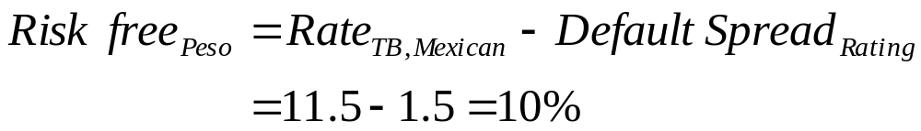
Estimating a Riskfree Rate when there are no default free entities….
Estimate a range for the riskfree rate in local terms:
  Subtract default spread from local government bond rate:
  Government bond rate in local currency terms - Default spread for Government in local currency
  For example: The Mexican peso bond rate is 11.5% and that the rating assigned to the Mexican government is A. If the default spread for A rated bonds is 1.5%, the riskless peso bond rate would be.
Do the analysis in a currency where you can get a riskfree rate, say US dollars.
Notes:
In general, while many practitioners use the last approach (working with a different, more stable currency) to avoid having to deal with inflation in the local currency, they shift the problem of making these estimates to the cashflows from the discount rates.
However, in case you choose the first approach, you might find it difficult to find the default spread. In that case you might want to consider an interchange between sovereign default spread and cds. The advantage of the CDS market is that the spreads are available on a lot more countries and are constantly updated.
You can find a further discussion of CDS here
https://en.wikipedia.org/wiki/Credit_default_swap
You can find data here
http://www.isdacdsmarketplace.com/
Another approach to estimate the risk free rate when there are no default free entities is the use of forward rates. (Purchasing parity or big mac index)
Use forward rates and the riskless rate in an index currency (say Euros or dollars) to estimate the riskless rate in the local currency. For example: If the current spot rate is 38.10 Thai Baht per US dollar, the ten-year forward rate is 61.36 Baht per dollar and the current ten-year US treasury bond rate is 5%, the ten-year Thai risk free rate (in nominal Baht) can be estimated as follows
Forward = Spot [(1+ Local Rate) / (1+ Foreign Rate)]
61.36 = 38.1[(1+ Local Rate) / (1 + 0.05)]
Local Rate is 10.12%

Slide 38
???s Greece less risky than the US???
Risk Free Rate Greece =
  Bond yield-Default premium
  3.43-2.48 = 0.95% (that is January)
  How Much is it now?
Risk Free Rate US =
  Bond yield
  4.19%
Notes:
Country risk (default) premiums are taken from Damodaran
https://pages.stern.nyu.edu/~adamodar/New_Home_Page/datafile/ctryprem.html
Please note that the default rates refer to the country (probability the country will default)
The equity risk premia refer to the private sector (probability that the private sector (e.g., listed firms) will default)

Slide 39
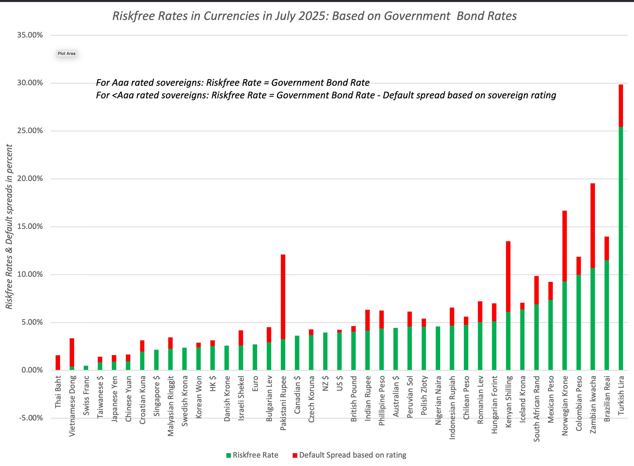
Why do risk free rates vary across currencies?
2021 Risk free rates
𝐹𝑖𝑠𝑘 𝐹𝑟𝑒𝑒 𝑅𝑎𝑡𝑒=10𝑦 𝑏𝑜𝑛𝑑 𝑦𝑖𝑒𝑙𝑑 −𝐷𝑅𝑃
Notes:
Data for the graph
www.stern.nyu.edu/~adamodar/pc/datasets/currencyriskfree2019.xls
http://aswathdamodaran.blogspot.com/2020/02/data-update-4-country-risk-and-currency.html (keep an eye for the update; usually around mid Feb).
Riskfree rates should vary primarily because of differences in expected inflation. Whatever you gain by using a low riskfree rate currency in your discount rate, you will lose in your expected growth rate.
You can also find a very nice discussion of the impact of inflation on risk free rates.
An interesting story on how the countries are interlinked and how this affects the value of the currency and thus inflation. Even more, we try to forecast the risk free rate. Inflation is important and we need to estimate its future value. The Fed has determined this for China. Try to think; how could somebody foresee or anticipate this move, without taking a bet against the market?
http://www.telegraph.co.uk/finance/economics/12141369/Dollar-tumbles-as-Fed-rescues-China-in-the-nick-of-time.html
Inflation affects even the value of crypto-currencies https://www.marketplace.org/2022/01/06/why-interest-rates-stocks-crypto-are-sometimes-correlated/

Slide 40
Case 4: International Companies from Emerging Economies
You are valuing Embraer, a Brazilian company, in U.S. dollars and are attempting to estimate a risk free rate to use in the analysis. The risk free rate that you should use is
  The interest rate on a Brazilian Real denominated long term bond issued by the Brazilian Government (15%)
  The interest rate on a US $ denominated long term bond issued by the Brazilian Government (C-Bond) (10.30%)
  The interest rate on a US $ denominated Brazilian Brady bond (which is partially backed by the US Government) (10.15%)
  The interest rate on a dollar denominated bond issued by Embraer (9.25%)
  The interest rate on a US treasury bond (4.29%)
Notes:
The correct riskfree rate is the treasury bond rate. The C-Bond has a default spread component -the additional country risk can be built into the equity risk premium..

Slide 41
What is the rf for Nestle?

Slide 42
ii. Market Equity Risk Premiums
The
premium investors require from the
market
(as a whole)
for average riskiness
(over the risk free rate)
A. Historical
(Backward)
Compute the average difference between past (realized) market return and past risk free rates
B.
Implied
(Forward)
Estimate the discount rate that makes the present value of an index cash flows equal to the index now
C.
Average Implied
(Both)
Compute the average implied market risk premium over a period of time

Slide 43
A. A Backward looking Market Risk Premium
Everyone uses historical premiums, but..
The historical premium is the premium that stocks have historically earned over riskless securities. They measure
  Risk aversion
  Riskiness of average security in a market
Practitioners never seem to agree on the premium; it is sensitive to
  How far back you go in history…
  Whether you use T.bill rates or T.Bond rates
  Whether you use geometric or arithmetic averages.
For instance, looking at the US:
 | Arithmetic Average |  | Geometric Average
 | Stocks - T. Bills | Stocks - T. Bonds | Stocks - T. Bills | Stocks - T. Bonds
1928-2020 | 8.28% | 6.43% | 6.47% | 4.84%
Std Error | 2.06% | 2.18%
1971-2020 | 7.67% | 4.90% | 6.35% | 3.91%
Std Error | 2.38% | 2.70%
2011-2020 | 13.83% | 9.70% | 13.24% | 9.35%
Std Error | 3.88% | 4.87%
Notes:
Data taken from (keep an eye for an update; around mid Feb)
https://seekingalpha.com/article/4400268-data-update-2-for-2021-price-of-risk
While everyone uses historical risk premiums, the actual premium in use can vary depending upon
How far back you go in time
Whether you T.Bills or T.Bonds
Whether you use arithmetic or geometric averages
This table was developed using data that is publicly accessible on the S&P 500, treasury bills and 10-year treasury bonds on the Federal Reserve of St. Louis web site.
An interesting issue that has been raised by some researchers is that there may be a selection bias here. The U.S. stock market was undoubtedly the most successful equity market of the 20th century. Not surprisingly, you find that it earned a healthy premium over riskless rates. A more realistic estimate of the premium would require looking at the ten largest equity markets in the early part of the century and estimating the average premium you would have earned over all ten markets. A study at the London Business School that did this found an average equity risk premium of only 4% across these markets.
Data is taken from
www.stern.nyu.edu/~adamodar/pc/datasets/histretSP.xls
If you choose to use historical premiums:
Go back as far as you can.
Be consistent in your use of the risk free rate. Since we argued for long term bond rates, the premium should be the one over T.Bonds
Use the geometric risk premium. It is closer to how investors think about risk premiums over long periods.
The noise in stock prices is such that you need 100-150 years of data to arrive at reasonably small standard errors. It is pointless estimating risk premiums with 10-20 years of data.
Consistent with our argument of using a treasury bond rate as a riskfree rate, we would estimate the premium over the treasury bond rate.
If you wanted a risk premium for the next year, you would use the arithmetic average - it is the single best estimate of next year’s premium. If you want a risk premium to use in a cost of equity which will be compounded over time, you should use a geometric average.

Slide 44
B. A Forward Looking Market Risk Premium
Implied Equity Premiums
If we assume that stocks are correctly priced in the aggregate and we can estimate the expected cash flows from buying stocks,
  We can estimate the expected rate of return on stocks by computing an internal rate of return.
  Subtracting out the riskfree rate should yield an implied equity risk premium.
This implied equity premium is a forward looking number and can be updated as often as you want
Notes:
The simplest analogy is to a bond. If you know the price of a bond, you can compute the yield to maturity as the discount rate that makes the present value of the expected cashflows on the bond equal to the price of the bond. Similarly, if you know the current market value of equities in the aggregate (or of an equity index), you can compute the discount rate that makes the present value of the expected cashflows on the index equal to the price of the index today.
There are two practical problems:
Unlike a bond, the cashflows on stocks are not promised but expected - you need an expected growth rate.
Unlike a bond, stocks have infinite lives. You have to consider cashflows forever.

Slide 45
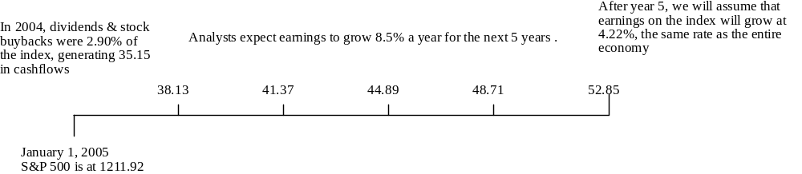
Implied Equity Premiums
We can use the information in stock prices to back out how risk averse the market is and how much of a risk premium it is demanding.
If you pay the current level of the index, you can expect to make a return of 7.87% on stocks (which is obtained by solving for r in the following equation)
You can use the interpolation method
Implied Equity risk premium = Expected return on stocks - Treasury bond rate = 7.87% - 4.22% = 3.65%
Notes:
The best analogy is to pricing a bond. If you know the price of a standard coupon bond, you can estimate the yield to maturity as the discount rate that equates the present value of the cashflows to the price of the bond today. We are doing the same with stocks collectively, and estimating the discount rate that will make the present value of the cashflows on stocks (dividends and stock buybacks) equal to the index level today.
Implied Risk Premium Dynamics
Assume that the index jumps 10% on January 2 and that nothing else changes. What will happen to the implied equity risk premium?
Implied equity risk premium will decrease
Assume that the earnings jump 10% on January 2 and that nothing else changes. What will happen to the implied equity risk premium?
Implied equity risk premium will increase
Assume that the riskfree rate increases to 5% on January 2 and that nothing else changes. What will happen to the implied equity risk premium?
Implied equity risk premium will decrease
All three tend to move at the same time though in different directions. For instance, as the economy strengthens, earnings and earnings growth will increase (which should push up premiums) and interest rates will increase(which will push down premiums). The net effect will show up in the index.

Slide 46
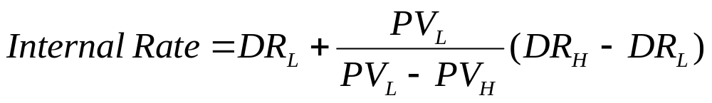
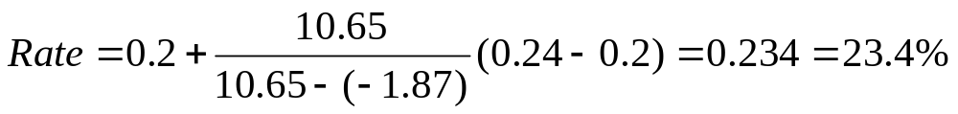
Interpolation Method
DR_{L}
20%
DR=?
DR_{H}
24%
PV_{L}
=10.65
PV
=0
PV_{H}
=-1.87
What is the Discount Rate, where PV is zero?

Slide 47
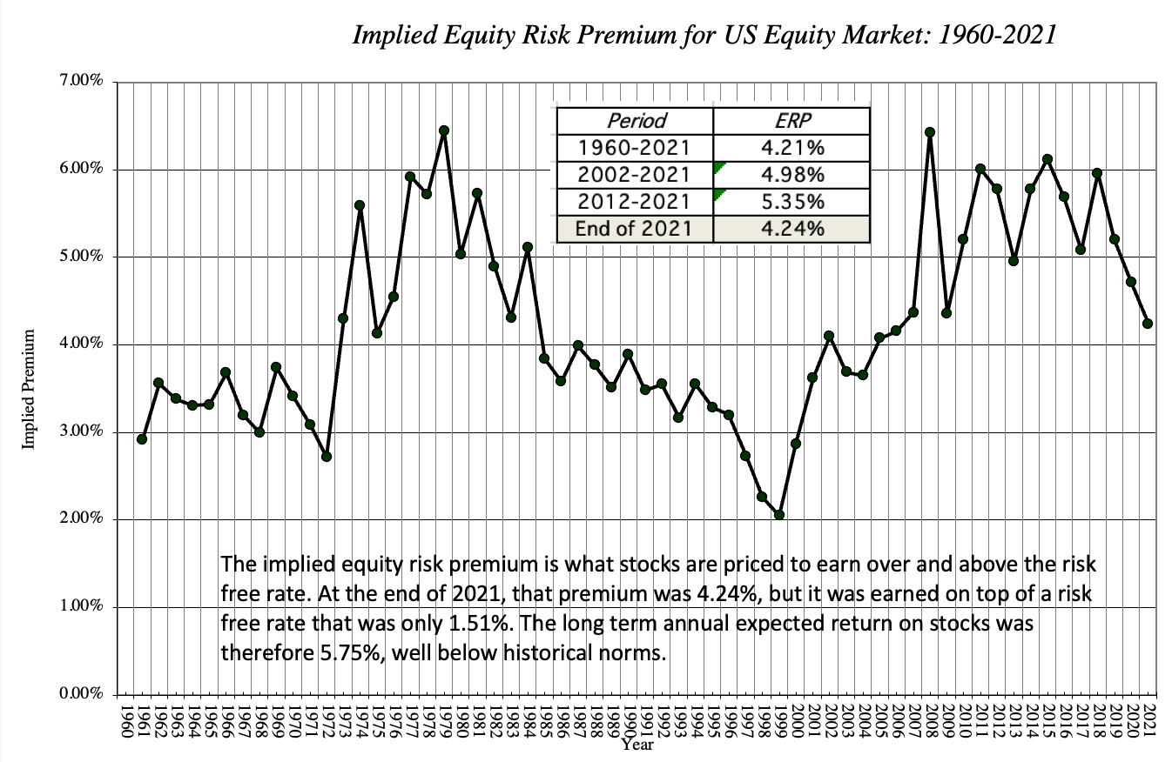
C. A bit of both Worlds
Average Implied Premiums (in the US)
Notes:
Data for the graph
http://pages.stern.nyu.edu/~adamodar/New_Home_Page/datafile/implpr.html
https://seekingalpha.com/article/4400268-data-update-2-for-2021-price-of-risk

Slide 48
Which equity risk premium should you use for the US?
Historical Risk Premium:
You are assuming that premiums will revert back to a historical norm and that
Current Implied Equity Risk premium:
You are assuming that the market is correct in the aggregate but makes mistakes on individual stocks.
Average Implied Equity Risk premium:
The average implied equity risk premium between 1960-2003 in the United States is about 4%.
You are also more likely to find stocks to be overvalued than undervalued (Why?)
The time period that you are using is the right norm.
If you are required to be market neutral, this is the premium you should use.
You are assuming that the market is correct on average but not necessarily at a point in time.
Notes:
Whenever the historical premium is higher than the current implied equity risk premium, you will be using a much higher discount rate than the market and consequently ending up with a much lower present value for stocks.
If you are required to be market neutral (as is the case with equity research analysits, equity mutual fund managers, acquisitions), where you are asked to value an individual stock and not pass judgment on the market, the best number to use is the current implied equity risk premium.

Slide 49
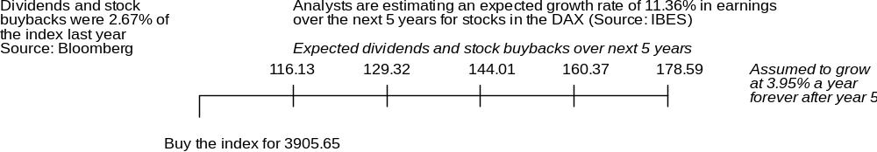
Example: Implied Equity Risk Premium for Germany
We can use the information in stock prices to back out how risk averse the market is and how much of a risk premium it is demanding.
If you pay the current level of the index, you can expect to make a return of 7.78% on stocks (which is obtained by solving for r in the following equation)
Implied Equity risk premium = Expected return on stocks - Treasury bond rate = 7.78% - 3.95% = 3.83%

Slide 50
Market Risk Premium: Now What?
Mature
Historical Risk Premia are around 4% to 5%
Emerging
Wide variation
Should we consider other factors?

Slide 51
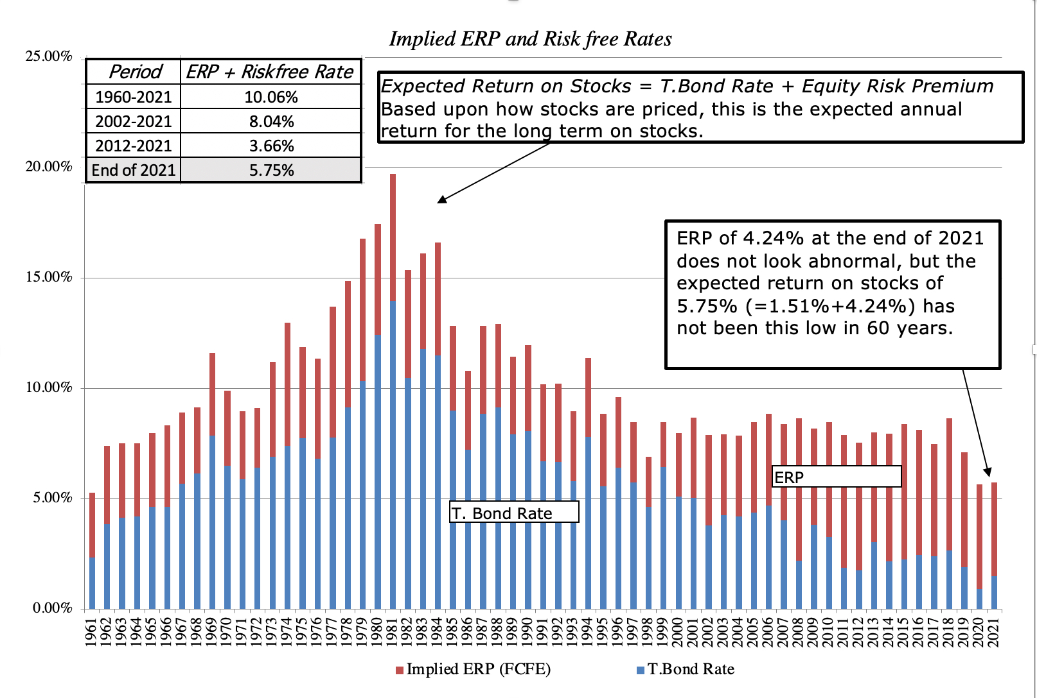
Risk Premium for a Mature Market? (Composition)
Notes:
Data for the graph
https://seekingalpha.com/article/4400268-data-update-2-for-2021-price-of-risk
The problem with using the risk premium in the United States is that there is a survivor bias - the U.S, was the most successful equity market of the 20th century…
In “The Triumph of the Optimists”, Dimson and his co-authors examined risk premiums in the largest equity markets of the 20th century and concluded that the average equity risk premium across these markets is about 4%.
We could use this as a reference. However, the Market premiums do change and exhibit trends. Think for example the market premium in 2007, 2009 and 2014. Before the crisis there was a period of irrational optimism and equities were earning a lot more than less risky government bonds. During the crisis, some government bonds were considered as safe options and the premium was a lot smaller. During the post crisis period equities rallied for a period and very high market premiums were observed.
Since we are forward looking, we should not ignore market trends.

Slide 52
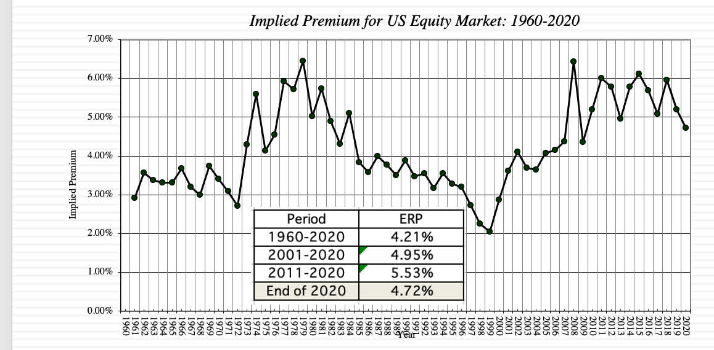
Mature Markets
Historically: 4%-5% should be ok
Are stocks Over- or Under- Valued?
Notes:
Data for this and the previous slide is taken from
www.stern.nyu.edu/~adamodar/pc/datasets/histimpl.xls

Slide 53
Emerging markets
Limited data history/access
Base Risk Premium (RP)
Country Risk Premium (CRP)
Total Market Equity Risk Premium
(ERP)
The Market risk premium (ERP) for a developing economy includes two elements
  The risk of a mature market failure, which would also affect the developing economy: Base Premium (RP)
  The risk of a developing economy failure due to country specific reasons: Country Risk Premium (CRP)
Notes:
The Market risk premium for a developing economy should include an additional element of risk (on top of the market (systematic) risk involved in advanced economies)
If the mature market fails, it is really likely that the developing market will fail too. So they face a “Base” market risk. The premium required for this type of risk is called Base Market Risk Premium (Base Premium)
However, there is an additional element of risk; the risk of the developing market to fail. This would not necessarily cause a “Base” market failure. Therefore, it is country specific. The premium required for this type of risk is called Country Risk Premium (CRP)

Slide 54
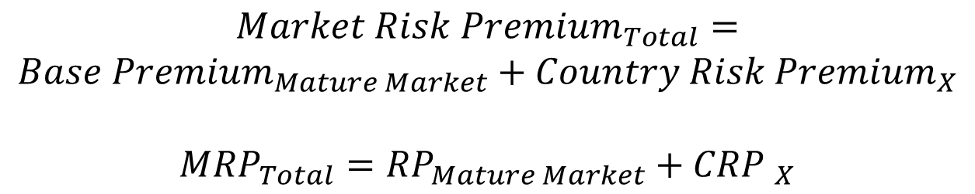
Estimate the Total Market Risk Premium
Default spread on Country Bond:
  In this approach, the country equity risk premium is set equal to the default spread of the bond issued by the country (in a currency where a default free entity exists).
Example
  Brazil was rated B2 by Moody’s and the default spread on the Brazilian dollar denominated C.Bond is 6.01%. What is the Total Market Premium if the Base Premium is 4.29%
$${Market Risk Premium}_{Total}=$$
$${Base Premium}_{Mature Market}+{Country Risk Premium}_{X}$$
$${MRP}_{Total}={RP}_{Mature Market}+{CRP }_{X}$$
Notes:
Many analysts use the default spread on the country bond as a measure of the extra risk premium to charge for that market. In fact, many leave this default spread in the riskless rate, thus adding it as a constant to every company in that market. Some double count it, by including it both in the riskless rate and by using a larger risk premium.
Another thing to note is that the country risk premium is not necessarily equal to the default spread. It might be higher or lower, depending on whether the private sector faces the same risks like the public. What is this suppose to mean? The DRP is the premium added on the risk free rate that shows how much riskier an economy (country/government) is. The Country premium measures how much riskier the market (private sector) is and the premium might be higher or lower. It is at our discretion to choose whether we want to use it or not. In the end of the day it depends on our perception about risk (systematic) that needs to be rewarded.
A discussion on Equity and country risk premia
http://www1.worldbank.org/finance/assets/images/Equity_Risk_Premiums.pdf
A critique against Country Risk Premia
http://papers.ssrn.com/sol3/papers.cfm?abstract_id=1651466
I hope you understand that we are talking about the future and making “fair” estimates. It obviously depends on the “point of view”.
More data can be found here
http://pages.stern.nyu.edu/~adamodar/
http://pages.stern.nyu.edu/~adamodar/New_Home_Page/datafile/ctryprem.html

Slide 55
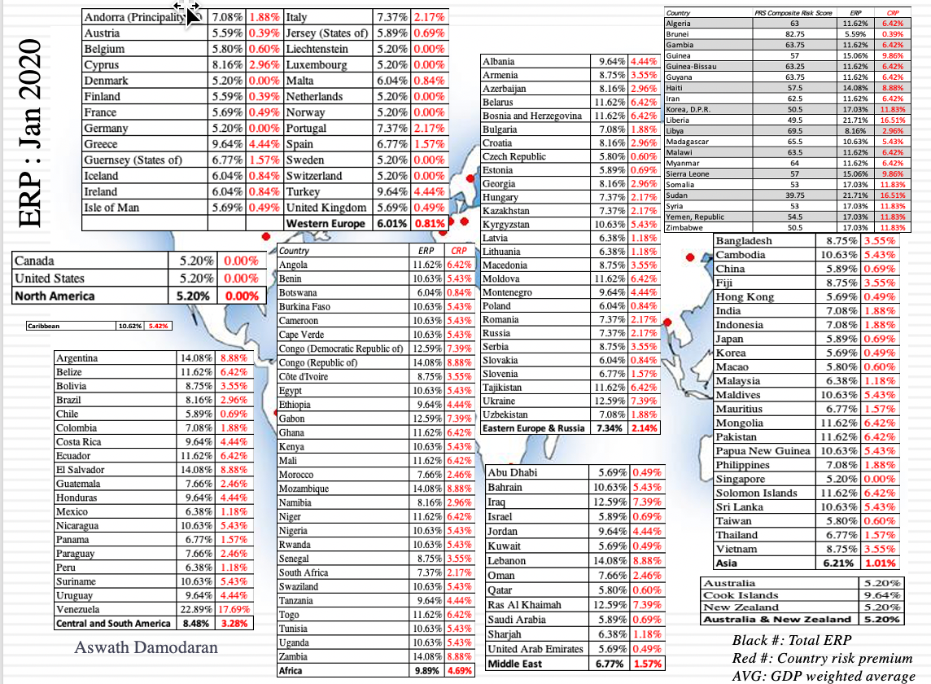
Can CRP change?
Notes:
Updates:
http://pages.stern.nyu.edu/~adamodar/New_Home_Page/datafile/ctryprem.html
or
http://countryeconomy.com/risk-premium
http://pages.stern.nyu.edu/~adamodar/New_Home_Page/datafile/ctryprem.html (Pr Damodaran (Stern BS) advises world bank on CRP)
An excellent, very detailed measurement of CRP can be found in EIKON (search for ERP)
A very interesting critique about the usefulness of the CDS market in estimating the overall riskiness, considering liquidity and speculation
http://www.euromoney.com/Article/3118876/Country-Risk-Is-this-the-end-for-CDS-spreads-as-a-useful-measure-of-sovereign-risk.html

Slide 56
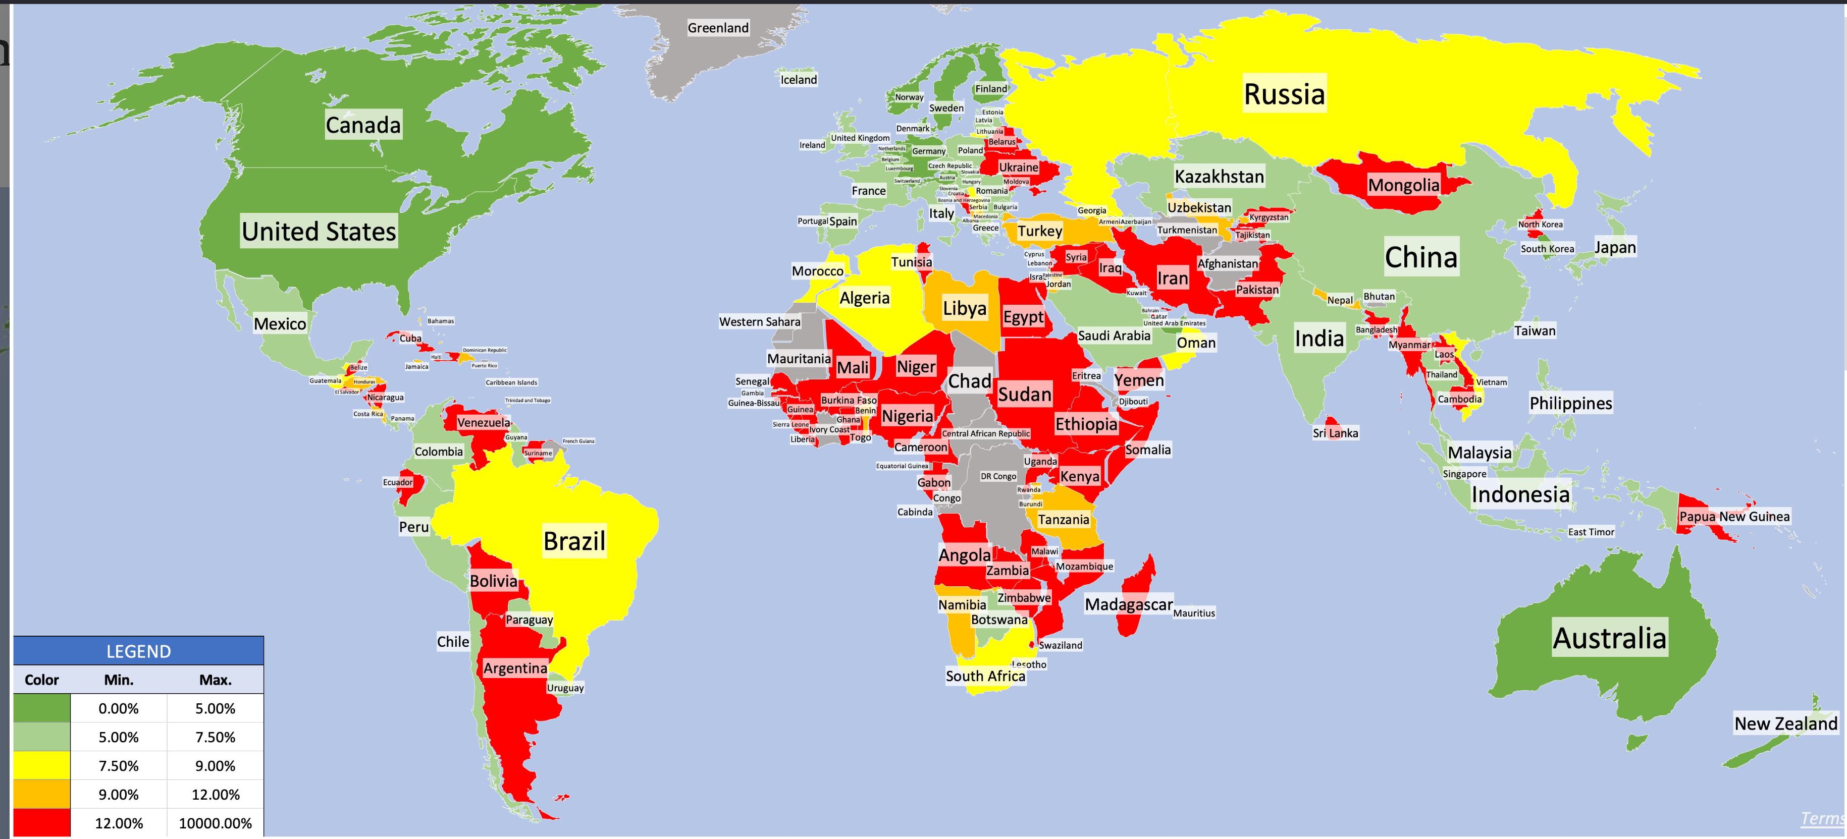
ERPs and CRPs correspond to ratings
Data from the link below
Notes:
Data
https://pages.stern.nyu.edu/~adamodar/pc/implprem/ERPJuly25.xlsx
More info
https://pages.stern.nyu.edu/~adamodar/New_Home_Page/datafile/ctryprem.html

Slide 57
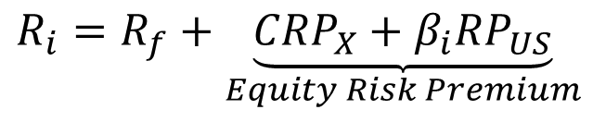
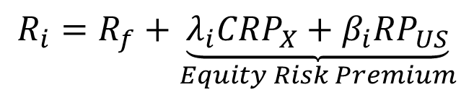
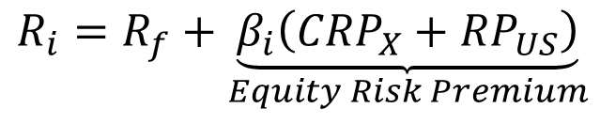
From Country Equity Risk Premiums to Corporate Equity Risk premiums
Approach 1 (Most General):
  Assume that every company in the country is equally exposed to country risk. In this case,
Approach 2 (Works well for most cases):
  Assume that a company’s exposure to country risk is similar to its exposure to other market risk.
Approach 3 (For extreme cases):
  Treat country risk as a separate risk factor and allow firms to have different exposures to country risk (perhaps based upon the proportion of their revenues come from non-domestic sales)
CRP: Country Risk Premium & RP_{US}: Base Premium (US)
$$R_{i}=R_{f}+\underset{Equity Risk Premium}{\underbrace{{CRP}_{X}+β_{i}{RP}_{US}}}$$
$$R_{i}=R_{f}+\underset{Equity Risk Premium}{\underbrace{β_{i}\left({CRP}_{X}+{RP}_{US}\right)}}$$
$$R_{i}=R_{f}+\underset{Equity Risk Premium}{\underbrace{λ_{i}{CRP}_{X}+β_{i}{RP}_{US}}}$$
Notes:
While many analysts use the first approach, it strikes us as unreasonable to tar all companies - large and small, domestic and export oriented - with the same brush. Implicitly, this is what you are assuming when you use the local Government’s dollar borrowing rate as your riskfree rate.
The second approach tends to work well for all but the most extreme examples - firms that derive the bulk of their revenues outside an emerging market.
For companies that derive most of their revenues from markets other than their domestic market, the third approach offers the most promise, though we are left with the question of how to estimate lambda. Lambda will look a lot like beta, averaging one across all stocks. A stock with a lambda greater than one is more exposed to country risk than the average stock.

Slide 58
Estimating Company Exposure to Country Risk: Determinants
Source of revenues:
Acompany should be more exposed to risk in a country if it generates more of its revenues from that country. A Brazilian firm that generates the bulk of its revenues in Brazil should be more exposed to country risk than one that generates a smaller percent of its business within Brazil.
Manufacturing facilities:
Other things remaining equal, a firm that has all of its production facilities in Brazil should be more exposed to country risk than one which has production facilities spread over multiple countries. The problem will be accented for companies that cannot move their production facilities (mining and petroleum companies, for instance).
Use of risk management products:
Companies can use both options/futures markets and insurance to hedge some or a significant portion of country risk.
Notes:
This is not meant to be an all inclusive list. While there are undoubtedly other factors to consider, you also have to be able to obtain this information not only on your firm but on other firms in the market. In fact, of the three items listed above, revenue sources may be the only publicly available information on companies.

Slide 59
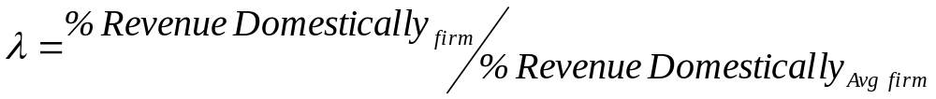
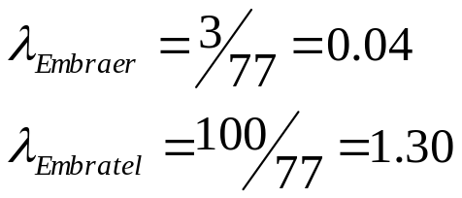
Estimating Lambdas: The Revenue Approach
The easiest and most accessible data is on revenues. Most companies break their revenues down by region. One simplistic solution would be to do the following:
Consider, for instance, Embraer and Embratel, both of which are incorporated and traded in Brazil. Embraer gets 3% of its revenues from Brazil whereas Embratel gets almost all of its revenues in Brazil. The average Brazilian company gets about 77% of its revenues in Brazil:
There are two implications
  A company’s risk exposure is determined by where it does business and not by where it is located
  Firms might be able to actively manage their country risk exposures (derivatives)
Notes:
This is a simplistic approach, but it is the easiest one to use. You can usually get the percent of revenues that your firm gets in the country from its annual report.
Notice that Embraer has a lambda close to zero since it gets so little of its revenues in Brazil. Since its factories and work force are still in Brazil, this estimate seems to be too low.

Slide 60
Estimating a US Dollar Cost of Equity for Embraer
Assume that
  the beta for Embraer is 1.07 and λ is 0.27
  the riskfree rate used is 4.29%.
  the risk premium for the US is 4.82%
  the country risk premium for Brazil is 7.89%.
Approach 1: Assume that every company in the country is equally exposed to country risk. In this case,
E(Return) = 4.29% + 1.07 (4.82%) + 7.89% = 17.34%
Approach 2: Assume that a company’s exposure to country risk is similar to its exposure to other market risk.
E(Return) = 4.29 % + 1.07 (4.82%+ 7.89%) = 17.89%
Approach 3: Treat country risk as a separate risk factor and allow firms to have different exposures to country risk (perhaps based upon the proportion of their revenues come from non-domestic sales)
E(Return)= 4.29% + 1.07(4.82%) + 0.27 (7.89%) = 11.58%
Notes:
Applies all three approaches to estimating the dollar cost of equity for Embraer. Note how much lower the cost of equity is with the lambda approach. Clearly, it will have a big impact on what value you arrive at for Embraer.
Valuing Emerging Market Companies with significant exposure in developed markets
The conventional practice in investment banking is to add the country equity risk premium on to the cost of equity for every emerging market company, notwithstanding its exposure to emerging market risk.
Thus, Embraer would have been valued with a cost of equity of 17.34% even though it gets only 3% of its revenues in Brazil.
Q. As an investor, which of the following consequences do you see from this approach?
A. Emerging market companies with substantial exposure in developed markets will be significantly under valued by equity research analysts.
Q. Can you construct an investment strategy to take advantage of the mis-valuation?
A. Analysts will routinely undervalue these companies because they will be using too high a discount rate. A good strategy to follow would be to buy these companies, preferably after a crisis in the emerging market in question. Investors tend not to be discriminating during crises and mark down all stocks in an emerging market and correct themselves later.

Slide 61
What happens if the company operates in many countries?
Option I: (weighted) Average of MRPs
Option II: ${RP}_{mature}$+(weighted) Average of CRPs
Option II: 〖𝑅𝑃〗_𝑚𝑎𝑡𝑢𝑟𝑒+(weighted) Average of CRPs
Option III: Assume beta captures all * ${MRP}_{market}$
Option III: Assume beta captures all * 〖𝑀𝑅𝑃〗_𝑚𝑎𝑟𝑘𝑒𝑡
Option IV: different λ different CRPs (too complicated)

Slide 62
What is the MRP for Nestle?

Slide 63
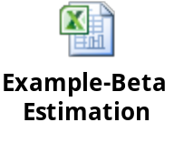
iii. Corporate Risk Premium
Estimating Beta
The standard procedure for estimating betas is to regress stock returns (R_{j}) against market returns (R_{m}) -
R_{j} = a + b R_{m}
  where a is the intercept and b is the slope of the regression.
The slope of the regression corresponds to the beta of the stock, and measures the riskiness of the stock.
This beta has three problems:
  It has high standard error
  It reflects the firm’s business mix over the period of the regression, not the current mix
  It reflects the firm’s average financial leverage over the period rather than the current leverage.
Notes:
Apart from the excel way, you can and are advised to use Bloomberg.
Some brief instructions
http://libguides.babson.edu/content.php?pid=10456&sid=69436
Please NOTE
The standard approach for estimating betas- regressions - leads to flawed and backward looking estimates of risk.
Regression betas suffer from the following
i. The Noise Problem
High standard errors mean, that these betas are still the best estimates (best average), but the average error is also high. In other words, it is the best description of the average behavior in the market, but this description is not good enough.
The index Effect
Think of Nokia. Nokia dominates the Helisinki index (it was 70% of the index at the time of this regression). Consequently, in contrast to the noise problem, standard errors will be very small. Beta is still the average and it describes well behavior in the market, but it also consist 70% of the market.
The reason it is misleading is because Nokia’s largest single investor was Barclays, which manages one of the worlds’ largest global index funds. Barclays would not view the beta of this regression as a good measure of risk. (They would probably prefer a beta estimate against a global equity index like the Morgan Stanley Capital Index).
The index Game
Furthermore, you can choose an index that minimizes beta estimates, as well standard errors. This way firms appear to be less risky. However…..
Don’t play it… You can get almost any beta for any company if you play the game long enough.
And don’t fall into the trap of picking an index to suit a particular investor. Just because you are analyzing Aracruz for a US investor does not change the marginal investor and cannot be used as a justification for staying with the S&P.

Slide 64
Solutions to the Regression Beta Problem
Modify the regression beta by
  changing the index used to estimate the beta
  adjusting the regression beta estimate, by bringing in information about the fundamentals of the company
Estimate the beta for the firm using
  the standard deviation in stock prices instead of a regression against an index
  accounting earnings or revenues, which are less noisy than market prices.
Estimate the beta for the firm from the bottom up without employing the regression technique. This will require
  understanding the business mix of the firm
  estimating the financial leverage of the firm
Use an alternative measure of market risk not based upon a regression.
Notes:
Changing the regression parameters, which is what we do in the first approach, will yield such a large range of betas (with large standard errors) that it will leave you more confused about the true beta of a firm rather than less confused.
While you can use standard deviations to compute a relative standard deviation, you are assuming that market risk and total risk are perfectly correlated. With accounting earnings, the biggest limitation is that you will have relatively few observations in your regression.
We prefer bottom-up betas….

Slide 65
Determinants of Betas
Beta of Firm
Financial Leverage:
Other things remaining equal, the greater the proportion of capital that a firm raises from debt, the higher its equity beta will be
Implications:
Highly levered firms should have higher betas than firms with less debt
Nature of Product:
Other things remaining equal, the more discretionary the product, the higher the beta
Implications:
1. Cyclical companies should have higher betas
2. Luxury goods firms should have higher betas
3. High priced goods firms should have higher betas
4. Growth firms should have higher betas.
Operating Leverage (Fixed Costs):
Other things remaining equal, the greater the proportion of fixed costs, the higher the beta.
Implications:
1. Firms with high infrastructure and fixed costs should have higher betas
2. Smaller firms should have higher betas
3. Young firms should have higher betas
Notes:
These are the three fundamentals that drive betas.
Firms that produce luxury goods (such as Gucci and Tiffanys) should have higher betas than firms that cater to more basic needs (Walmart). These firms tend to have revenues that are much more sensitive to changes in economic conditions.
Firms in businesses with high fixed cost structures (like airlines) should have higher betas than firms with more flexible cost structures.
Firms that borrow more money will have higher equity betas than otherwise similar firms that do not borrow money.

Slide 66
In a perfect world… we would estimate the beta of a firm by doing the following
Start with the pure beta of the business that the firm is in
For the US: https://pages.stern.nyu.edu/~adamodar/New_Home_Page/datafile/Betas.html
Adjust the business beta for the operating leverage of the firm to arrive at the unlevered beta for the firm
Unlevered beta=
Pure business beta *(1 + (Fixed costs/ Variable costs))
Use the financial leverage of the firm to estimate the equity beta for the firm
Levered Beta=Unlevered Beta(1+(1-T)*(D/E))
Notes:
A more up to date reference (check it for an update)
http://pages.stern.nyu.edu/~adamodar/New_Home_Page/dataarchived.html#variables
Look for “Total beta by industry sector” and select the country and year of interest
https://pages.stern.nyu.edu/~adamodar/New_Home_Page/datafile/Betas.html
Adjusting for operating leverage
Within any business, firms with lower fixed costs (as a percentage of total costs) should have lower unlevered betas. If you can compute fixed and variable costs for each firm in a sector, you can break down the unlevered beta into business and operating leverage components.
Unlevered beta=
Pure business beta *
(1 + (Fixed costs/ Variable costs))
The biggest problem with doing this is informational. It is difficult to get information on fixed and variable costs for individual firms.
In practice, we tend to assume that the operating leverage of firms within a business are similar and use the same unlevered beta for every firm.
The standard practice of using the same unlevered beta for all firms will overstate betas for firms that have low fixed costs because of strategic decisions that they have made over time (such as Southwest in the Airline business) and understate betas for smaller firms in large infrastructure businesses where fixed costs tend to be much higher early in a firm’s life cycle.

Slide 67
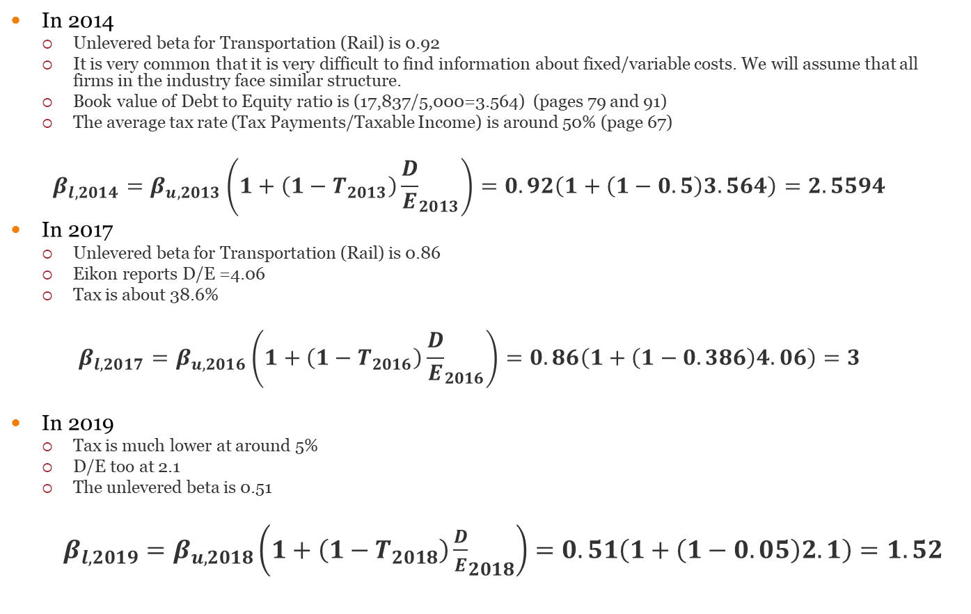
An Example: SNCF
In 2014
  Unlevered beta for Transportation (Rail) is 0.92
  It is very common that it is very difficult to find information about fixed/variable costs. We will assume that all firms in the industry face similar structure.
  Book value of Debt to Equity ratio is (17,837/5,000=3.564) (pages 79 and 91)
  The average tax rate (Tax Payments/Taxable Income) is around 50% (page 67)
  $$β_{l,2014}=β_{u,2013}\left(1+\left(1−T_{2013}\right){\frac{D}{E}}_{2013}\right)=0.92\left(1+\left(1−0.5\right)3.564\right)=2.5594$$
In 2017
  Unlevered beta for Transportation (Rail) is 0.86
  Eikon reports D/E =4.06
  Tax is about 38.6%
  $$β_{l,2017}=β_{u,2016}\left(1+\left(1−T_{2016}\right){\frac{D}{E}}_{2016}\right)=0.86\left(1+\left(1−0.386\right)4.06\right)=3$$
In 2019
  Tax is much lower at around 5%
  D/E too at 2.1
  The unlevered beta is 0.51
  $β_{l,2019}=β_{u,2018}\left(1+\left(1−T_{2018}\right){\frac{D}{E}}_{2018}\right)=0.51\left(1+\left(1−0.05\right)2.1\right)=1.52$
Notes:
You can find the annual report of SNCF (2013) here
http://www.sncf.com/ressources/reports/sncf_rf_gb_simple_0.pdf
Unbelievably difficult to find meaningful information. This is a characteristic example of efforts to divert attention from vital information. SNCF has had a rather unprofitable year to due to decreased number of passengers, high (market value of) loans and increased labour costs. The annual report is written in a way to divert attention to new investments, as well as changes in macroeconomic conditions, such as in page 18
http://www.sncf.com/ressources/reports/sncf_group_2013_annual_results_pres.13.02.2014_eng.pdf
The most up to date data is taken from Thomson Reuters EIKON for the SNCF Group (SNCF Mobilites EPIC).
Debt to equity has improved drastically post 2016
2016: 4.41
2017: 4.06
2018: 2.1
The tax rate is significantly lower this year due to lower income at about 5%
After 2018 there was a heavy impact of strikes, market reforms and coronavirus and equity is negative. Therefore, this procedure is rather inappropriate in estimating beta. Further info for SNCF investor relations can be found here:
https://medias.sncf.com/sncfcom/finances/Groupe_SNCF/SNCF_GROUPE_Investor_Presentation_jan.2020.pdf
http://medias.sncf.com/sncfcom/pdf/finance/ratings/Fitch_Ratings_SNCF_Mobilites_16.10.2018.pdf
https://www.sncf-reseau.com/sites/default/files/2019-02/SNCF%20RESEAU%20REFORME%20-%20INVESTOR%20PRESENTATION%202019.pdf

Slide 68
Consolidated Firm
Sector A
Sector B
Sector C
$$β_{A}$$
𝛽_𝐴
Un-lever beta: $β_{u,A}$
Un-lever beta: 𝛽_(𝑢,𝐴)
$$β_{B}$$
𝛽_𝐵
Un-lever beta: $β_{u,B}$
Un-lever beta: 𝛽_(𝑢,𝐵)
$$β_{C}$$
𝛽_𝐶
Un-lever beta: $β_{u,C}$
Un-lever beta: 𝛽_(𝑢,𝐶)
% of Value from C
% of Value from B
% of Value from A
Weight Average of $β_{u,i}$
$→$ $β_{u,F}$
Weight Average of 𝛽_(𝑢,𝑖)
→ 𝛽_(𝑢,𝐹)
Lever $β_{u,F}$
Lever 𝛽_(𝑢,𝐹)
$$β_{l,F}$$
𝛽_(𝑙,𝐹)

Slide 69
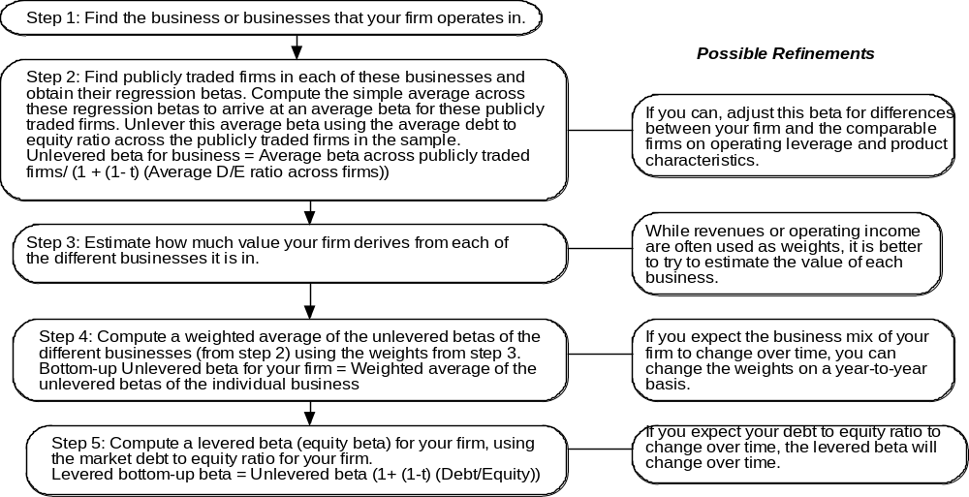
Bottom-up Betas-Multiple Businesses
Notes:
Three measurement issues come up:
How broadly or narrowly do we define comparable firms?
We would argue for a broader rather than a narrow definition, because the savings in standard error increase with the number of firms.
How do we deal with differences in operating leverage and business mix that may persist across these firms?
Assume that there are no differences in operating leverage and business mix or that the differences average out.
Adjust for the differences quantitatively. For instance, you could decompose the unlevered beta further into a business beta and the operating leverage effect:
Unlevered beta = Business beta (1 + (Fixed Cost/Variable costs))
How do we compute an average - simple or weighted?
You should prefer simple averages. Otherwise, your betas reflect those of the largest and most stable firms in the business.

Slide 70
Multiple Betas Example: Disney (value weights)
Industries | Comparable | Unlevered Beta | Revenue | Value/Revenue | Weight | Weighted Beta
Media Networks | Media and TV Broadcasting | 1.0932 | 19,436 | 3.41 | 55.74% | 0.6094
Parks and Resorts | Theme Park Entertainment | 0.9364 | 12,920 | 2.37 | 25.75% | 0.2412
Studio Entertainment | Movie Cos | 1.3310 | 5,825 | 2.63 | 12.89% | 0.1715
Consumer Products/ Interactive | Toy and Apparel retailers/ Entertainment Sftw | 1.2186 | 4,097 | 1.63 | 5.62% | 0.0684
Overall |  |  |  |  |  | 1.0905
Estimate a levered beta for Disney
Market debt to equity ratio = 20.28%
Marginal tax rate = 33.3%
Levered beta = 1.0905*( 1 + (1- .333) (.2028)) = 1.238
Notes:
Annual Reports can be found here
http://thewaltdisneycompany.com/investors/financial-information/annual-report
Annual Report 2012, p 31
Some information on how you can extract data from Bloomberg
http://researchguides.library.yorku.ca/bloomberg/industry
https://www.claremontmckenna.edu/fei/bloomberg/BloombergTutorialFinal.pdf
The unlevered betas (corrected for cash) and the enterprise value to sales ratios were obtained by looking at comparable firms in each of Disney’s businesses. The weightings are computed as following. The value is estimated using the multiple Value/Revenue of comparable firms in the four industries (Media and TV broadcasting, Theme Parks, etc.).
Let s say that the Value/Revenue is 10. This means that a firm derives $10 of value out of each $1 of revenue. Consequently, for Media and TV the value derived is 19,436 x 3.41. We do the same for Theme parks, Movies and Toys and then compute the weightings.
Please NOTE: Should you adjust betas for a company’s cash holdings?
It depends on how you will approach valuation. If you are valuing the non-cash or operating assets of the firm first and adding the cash back at the end (which is the conventional practice in firm valuation), you should not adjust the equity beta for the cash holdings of the firm. If you are valuing cash as part of the firm, which is what you implicitly do when you use net income as your base for estimating dividends or free cashflows to equity, you should adjust the beta for the cash holdings of the firm. Very simply, the beta for the firm inclusive of cash will be
Beta of non-cash assets (Non-cash Assets/ Firm Value) + 0 (Cash/ Firm Value).
Debt to Equity is derived as follows.
Market value of Equity=Share price x number of shares
Market Value of Debt (p. 57) is $18,586m
p.34 number of shares = Total Dividend/Dividend per share = 1.1b/0.6=1,833,333,333.
Average share price for 2012 $50.
Market Value of Equity = $91,667m
D/E= 20.28%
Tax Rate p. 37 =33.3%

Slide 71
Multiple Betas Example: Disney (Revenue weights)
Industries | Comparable | Unlevered Beta | Revenue | Weight | Weighted Beta
Media Networks | Media and TV Broadcasting | 1.0932 | 19,436 | 45.97% | 0.5026
Parks and Resorts | Theme Park Entertainment | 0.9364 | 12,920 | 30.56% | 0.2862
Studio Entertainment | Movie Cos | 1.3310 | 5,825 | 13.78% | 0.1834
Consumer Products/ Interactive | Toy and Apparel retailers/ Entertainment Sftw | 1.2186 | 4,097 | 9.69% | 0.1181
Overall |  |  |  |  | 1.0902
Estimate a levered beta for Disney
Market debt to equity ratio = 20.28%
Marginal tax rate = 33.3%
Levered beta = 1.0902*( 1 + (1- .333) (.2028)) = 1.238
Notes:
Annual Reports can be found here
http://thewaltdisneycompany.com/investors/financial-information/annual-report
Annual Report 2012, p 31
Some information on how you can extract data from Bloomberg
http://researchguides.library.yorku.ca/bloomberg/industry
https://www.claremontmckenna.edu/fei/bloomberg/BloombergTutorialFinal.pdf
The unlevered betas (corrected for cash) and the enterprise value to sales ratios were obtained by looking at comparable firms in each of Disney’s businesses. The weightings are computed as following. The value is estimated using the multiple Value/Revenue of comparable firms in the four industries (Media and TV broadcasting, Theme Parks, etc.).
Let s say that the Value/Revenue is 10. This means that a firm derives $10 of value out of each $1 of revenue. Consequently, for Media and TV the value derived is 19,436 x 3.41. We do the same for Theme parks, Movies and Toys and then compute the weightings.
Please NOTE: Should you adjust betas for a company’s cash holdings?
It depends on how you will approach valuation. If you are valuing the non-cash or operating assets of the firm first and adding the cash back at the end (which is the conventional practice in firm valuation), you should not adjust the equity beta for the cash holdings of the firm. If you are valuing cash as part of the firm, which is what you implicitly do when you use net income as your base for estimating dividends or free cashflows to equity, you should adjust the beta for the cash holdings of the firm. Very simply, the beta for the firm inclusive of cash will be
Beta of non-cash assets (Non-cash Assets/ Firm Value) + 0 (Cash/ Firm Value).
Debt to Equity is derived as follows.
Market value of Equity=Share price x number of shares
Market Value of Debt (p. 57) is $18,586m
p.34 number of shares = Total Dividend/Dividend per share = 1.1b/0.6=1,833,333,333.
Average share price for 2012 $50.
Market Value of Equity = $91,667m
D/E= 20.28%
Tax Rate p. 37 =33.3%

Slide 72
Why bottom-up betas?
The standard error in a bottom-up beta will be significantly lower than the standard error in a single regression beta.
The bottom-up beta can be adjusted to reflect changes in the firm’s business mix and financial leverage. Regression betas reflect the past.
You can estimate bottom-up betas even when you do not have historical stock prices. This is the case with initial public offerings, private businesses or divisions of companies.
Notes:
While we still use regression betas to compute bottom-up betas, the law of large numbers works in your favor. The average of a large number of imprecise betas is more precise than any one regression beta. The reason we unlever and relever is because different firms may have different debt ratios.
Even if a company is in a single business and has not changed its business over time, the bottom up beta should dominate a regression beta. If a company has changed its business mix, the argument for bottom up betas becomes irrefutable.

Slide 73
What is the beta for Nestle?

Slide 74
The Cost of Equity: A Recap
Cost of Equity
CAPM
Risk Free Rate
Market Risk Premium
Implied Cost of Equity
Growth Models
Beta
No Growth
Stable Growth
Stable % of Net Income
Historical
Implied
Historical
Bottom Up
Default Spread
Average Implied
Notes:
Big Picture of Cost of Equity

Slide 75
Cost of equity for Nestle

Slide 76
Cost of Debt
Cost of borrowing using new Debt
New Bonds
Theoretical
Yield to maturity

Slide 77

a. Estimating the Cost of Debt
The cost of debt is the rate at which you can borrow at currently, It will reflect not only your default risk but also the level of interest rates in the market.
The two most widely used approaches to estimating cost of debt are:
  Looking up the yield to maturity on a straight bond outstanding from the firm. The limitation of this approach is that very few firms have long term straight bonds that are liquid and widely traded
    Questions 11, 12 and 13 in “Introduction Questions”
  Looking up the rating for the firm and estimating a default spread based upon the rating. While this approach is more robust, different bonds from the same firm can have different ratings. You have to use a median rating for the firm
When in trouble (either because you have no ratings or multiple ratings for a firm), estimate a synthetic rating for your firm and the cost of debt based upon that rating.
Notes:
The cost of debt is not the rate at which you borrowed money historically. That is why you cannot use the book cost of debt in the cost of capital calculation.
While many companies have bonds outstanding, corporate bonds often have special features attached to them and are not liquid, making it difficult to use the yield to maturity as the cost of debt.
While ratings are often useful tools for coming up with the cost of debt, there can be problems:
A firm can have multiple ratings. You need a rating across all of a firm’s debt, not just its safest…
A firm’s bonds can be structured in such a way that they can be safer than the rest of the firm’s debt - they can be more senior or secured than the other debt of the firm.
A further note on default spread computations: COUNTRY RISK
Cost of Debt computations
Country Risk
in countries with low bond ratings and high default risk might bear the burden of country default risk, especially if they are smaller or have all of their revenues within the country.
Larger companies that derive a significant portion of their revenues in global markets may be less exposed to country default risk. In other words, they may be able to borrow at a rate lower than the government.
Decision on Country Default spread-proportion
The synthetic rating for Embraer is A-.default spread of 1.00%
We use a risk free rate of 4.29% and
add in two thirds of the country default spread of 6.01%:
Cost of debt
= Riskfree rate + 2/3(Brazil country default spread) + Company default spread =4.29% + 4.00%+ 1.00% = 9.29%
When estimating the cost of debt for an emerging market company, you have to decide whether to add the country default spread to the company default spread when estimating the cost of debt.
For smaller, less well known firms, it is safer to assume that firms cannot borrow at a rate lower than the countries in which they are incorporated. For larger firms, you could make the argument that firms can borrow at lower rates. In practical terms, you could ignore the country default spread or add only a fraction of that spread.

Slide 78
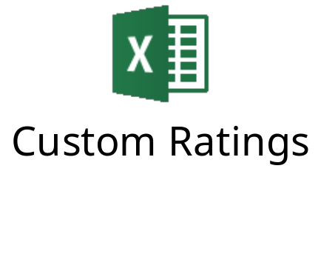
Estimating Synthetic Ratings
The rating for a firm can be estimated using the financial characteristics of the firm. In its simplest form, the rating can be estimated from the interest coverage ratio
Interest Coverage Ratio = EBIT / Interest Expenses
Notes:
More up to date data
http://people.stern.nyu.edu/adamodar/New_Home_Page/datafile/ratings.html
This is a simplistic approach but it uses the ratio that explains the largest proportion of the differences between ratings at non-financial service U.S. companies - I tried the 8 ratios that S&P said it depends upon the most to rate companies (which are available on its web site) and correlated them with bond ratings in 1999.
You could expand this approach to incorporate other ratios and create a score - similar to the Altman Z score - but you have to decide on whether the trade off is worth it - more complexity for less transparency.
An excellent reading on credit ratings
https://wiki.treasurers.org/wiki/Corporate_credit_ratings:_a_quick_guide
Problems with Interest Coverage Ratios and Synthetic Ratings
The relationship between interest coverage ratios and ratings, developed using US companies, tends to travel well, as long as we are analyzing large manufacturing firms in markets with interest rates close to the US interest rate
They are more problematic when looking at smaller companies in markets with higher interest rates than the US.
To develop an interest coverage ratio/ratings table, you need lots of rated firms and objective ratings agencies. This is most feasible in the United States. As long as interest rates in another country are similar to those in the United States, the ratings yielded by the table are fairly reasonable. When interest rates are high, interest coverage ratios will come under downward pressure and the table may need to be adjusted to reflect this.

Slide 79
Custom Rating and Interest Coverage

Slide 80
Custom Ratings and Default Risk Premium

Slide 81
DRPs change over time….

Slide 82
… and maturity (2014)

Slide 83
What is the cost of debt for Nestle?

Slide 84
We should know that Interest Payments are Tax Deductible
Assume a company with £1,000,000 capital.
  At the moment it is an all Equity firm
  There is a plan to borrow, issuing a 30y bond at 10% interest rate, which is equal to the yield to maturity.
  Assume that NI is distributed as dividend and tax is 20%
The two plans are
 | All Equity | 30% Debt
Equity | 1,000,000 | 700,000
Debt | 0 | 300,000
Interest | 0 | 30,000

Slide 85
 | All Equity | 30% Bonds
Sales | 1,000 | 1,000
-Costs | 300 | 300
EBIT | 700 | 700
Interest | 0 | 30
Before Tax | 700 | 670
TAX | 140 | 134
Net Income | 560 | 536
Equity | 1,000 | 700
Flows to Equity | 560 | 536

Slide 86


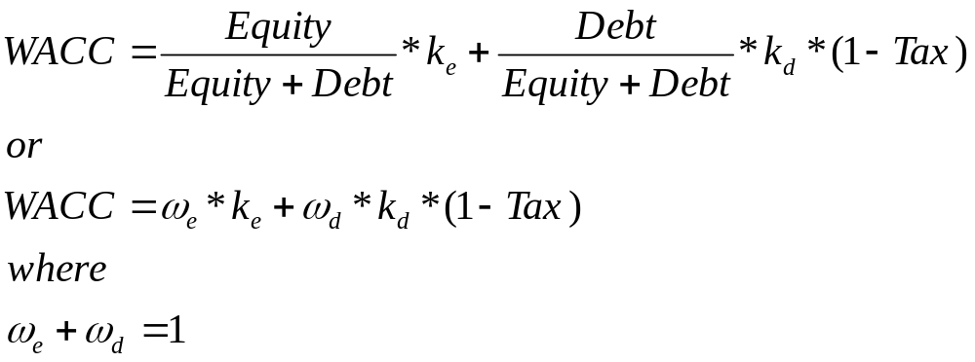
WACC
Weighted Average Cost of Capital
Are the proportion of equity and bank/bond borrowing.
ALWAYS USE MARKET VALUATION FOR BONDS AND EQUITY
Tax Shield
Notes:
You could read this interesting article
http://www.investopedia.com/articles/fundamental/03/061103.asp
The weights used to compute the cost of capital should be the market value weights for debt and equity.
The market value of equity can be found by multiplying the share price times the number of shares. There is an element of circularity that is introduced into every valuation by doing this, since the values that we attach to the firm and equity at the end of the analysis are different from the values we gave them at the beginning. If we iterate the process two or three times we can reach a stable D/E ratio and market value of equity.
The market value of debt is usually very close to the book value. However, if the company holds long corporate bonds and its financial situation has changed a lot, the market value should not be expected to be the same. In this case we can treat the total borrowing as a single bond. The face value of the bond is the total book value. The coupons should be equal the current (or the average if you want) interest payment. The yield to maturity should be the cost of debt, which could be reported or estimated based on default spreads.
As a general rule, the debt that you should subtract from firm value to arrive at the value of equity should be the same debt that you used to compute the cost of capital.
The rationale for using market values is simple. You are considering how much someone who would buy the company today should be willing to pay for the company. Since he or she can buy equity and debt at today’s market value, you use those as weights. However, you could very well push the market values towards your estimated values in the process of buying the company. If this is a concern, you can iterate the weights in the cost of capital calculation to make the values used in the weights converge on the values estimated in the analysis.

Slide 87
Example
The market value of Equity capital of Jordan plc is £350,000.
The beta of the company is 1.3. The market return is 15%. 3 month government bonds offer a 3% return.
The market value of Debt capital is £650,000. The yield to maturity is equal to the coupon rate, which is 5%.
What is the Cost of Capital of Jordan plc.
The Tax Rate is 30%

Slide 88
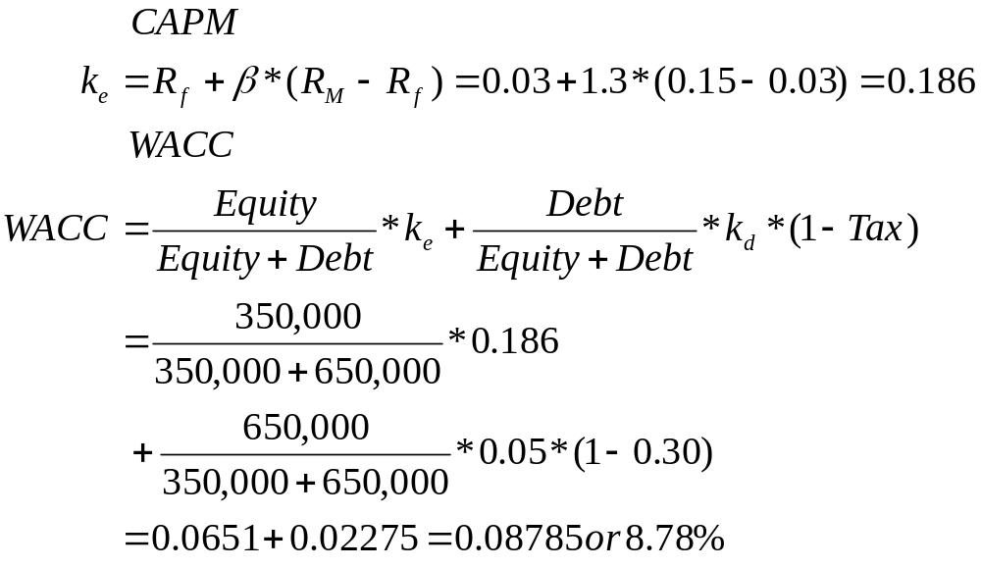
Solution

Slide 89
Finally: Cost of debt for Nestle

Slide 90
Hybrid Financing
Cost of borrowing using Hybrid Assets
Hybrid Assets
Split or weight
Preference Shares
CoCos

Slide 91
Dealing with Hybrids and Preferred Stock
When dealing with hybrids (convertible bonds, for instance), break the security down into debt and equity and allocate the amounts accordingly. Thus, if a firm has $ 125 million in convertible debt outstanding, break the $125 million into straight debt and conversion option components. The conversion option is equity.
When dealing with preferred stock, it is better to keep it as a separate component. The cost of preferred stock is the preferred dividend yield. (As a rule of thumb, if the preferred stock is less than 5% of the outstanding market value of the firm, lumping it in with debt will make no significant impact on your valuation).
Notes:
Keep your cost of capital simple. If possible, consolidate all of your capital into either debt or equity. With convertible bonds, this is fairly simple to do. With preferred, you do have a problem since its non-tax deductible status makes it unlike debt and it certainly is not equity. Here, you would make the exception and allow for a third source of capital. (In practice, I would do this only if preferred stock were more than 5% of capital in market value terms. Otherwise, you should ignore it for purposes of analysis).
The cost of preferred stock is the preferred dividend yield.
Decomposing a convertible bond
Assume that the firm that you are analyzing has $125 million in face value of convertible debt with a stated interest rate of 4%, a 10 year maturity and a market value of $140 million. If the firm has a bond rating of A and the interest rate on A-rated straight bond is 8%, you can break down the value of the convertible bond into straight debt and equity portions.
Straight debt =PV 0f Future CF
= (4% of $125 million) (PV of annuity, 10 years, 8%) + 125 million/1.08¹⁰ = $91.45 million
Equity portion =Residual Market value
= $140 million - $91.45 million = $48.55 million
The alternative approach is to use an option pricing model to value the conversion option and use that value as the value of the equity portion.
In practice, here are a few problems that you may run into:
The bond may not be traded. The best solution here is to value the conversion option. If this is not feasible, use the face value as market value.
The value of the straight bond exceeds the market price. If this happens, treat the entire bond as debt since equity options cannot have a negative value.
The firm is not rated and has no straight debt. You have to use a synthetic rating to get a cost of debt.

Slide 92
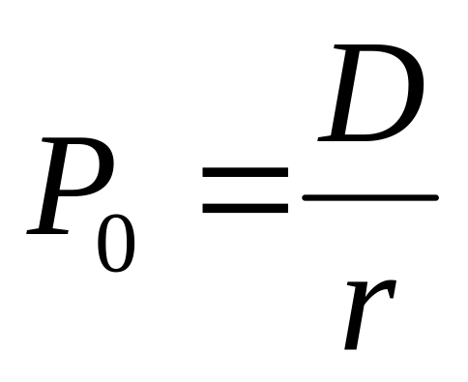
Cost of Equity-Preferred Shares
Characteristics
  Part of Equity
  Priority in Dividends over Ordinary shares
  Seniority in company’s assets over Ordinary shares
  In-between Equity and debt
  Similar to Debenture Stock (no collateral)
Cost of borrowing
  They are perpetuities
  Constant Dividend

Slide 93
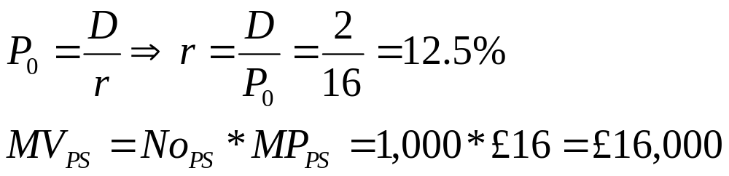
Preferred Shares
Birmingham International plc has issued 1,000 preferred shares. The Dividend is set to be £2 annually. Investors were willing to pay £16 per share.
What is the cost of borrowing for Birmingham International?
What is the market value of Preferred Share capital?

Slide 94
Let s see that in practice
A company has
  5m outstanding shares that cost £2 each. The last dividend was 5p and it is expected to grow by 10% indefinitely.
  100,000, 5%, 1 year debentures, currently selling at £95.
  2m preferred stock that cost 5£ each. The dividend is 0.10.
The marginal tax rate is 30%
What is the firm’s WACC if the firm plans to finance with new issues?

Slide 95
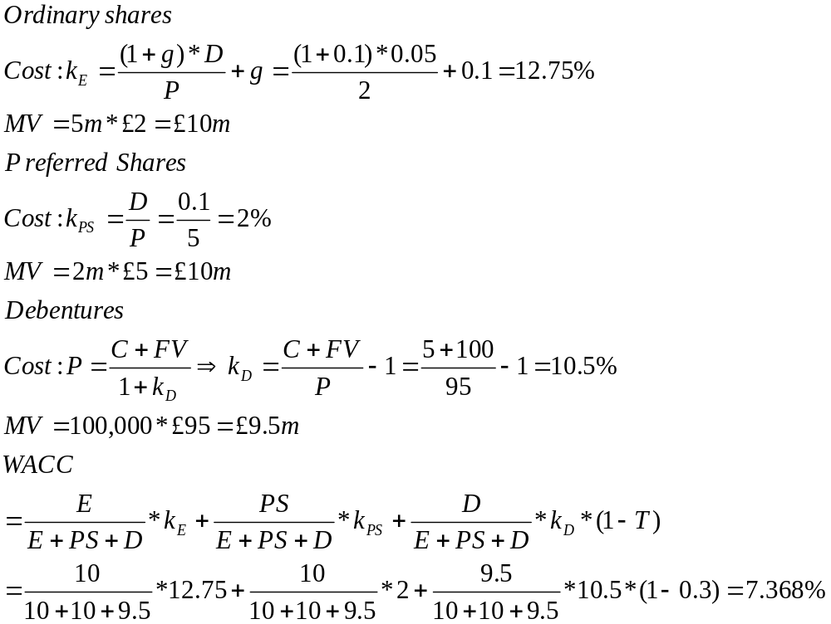
Note that capital now consists of
Equity
Preferred Stock and
Debt

Slide 96
Further Issues-Hierarchies in Long-Term Financing-Debt comes first
Senior Secured Debt
Senior Unsecured Debt
Unsecured Debt/
Debentures
Shareholder Loans
Preference Shares/
Debenture Stock
Ordinary Equity

Slide 97
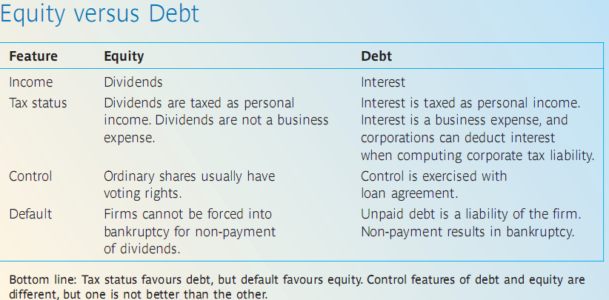
Further Issues-Equity vs Debt
Notes:
Things that we need to remember
Why Debt?
Cheaper
Why Cheaper?
Less risky
Seniority: It comes before equity
Cash Flows: Coupons are certain, Dividends are
Tax benefit: Interest payments are tax deductible, Dividends are not

Slide 98

Case Study

Slide 99
Cost of
Capital
Equity
Cost of Equity
k_{e}
Debt
Cost of Bank Borrowing/Bonds
k_{d}
Interest Rate
Default Spread
CAPM
Yield to Maturity
Hybrid Assets
Growth
Models

